Slide 1
Cloud storage 101
Indian prairie library July 18, 2018

Slide 2
Cloud storage 101
Computer Storage vs. cloud storage
Benefits/drawbacks
Basics of use
Major services
Quick tour
questions
Notes:
What we’ll cover today – where did cloud storage come from? how has computer storage evolved
Some of the benefits and issues to be aware of
How are most of these storage sites used
What are my options for using cloud storage right now
What does it look like in use

Slide 3
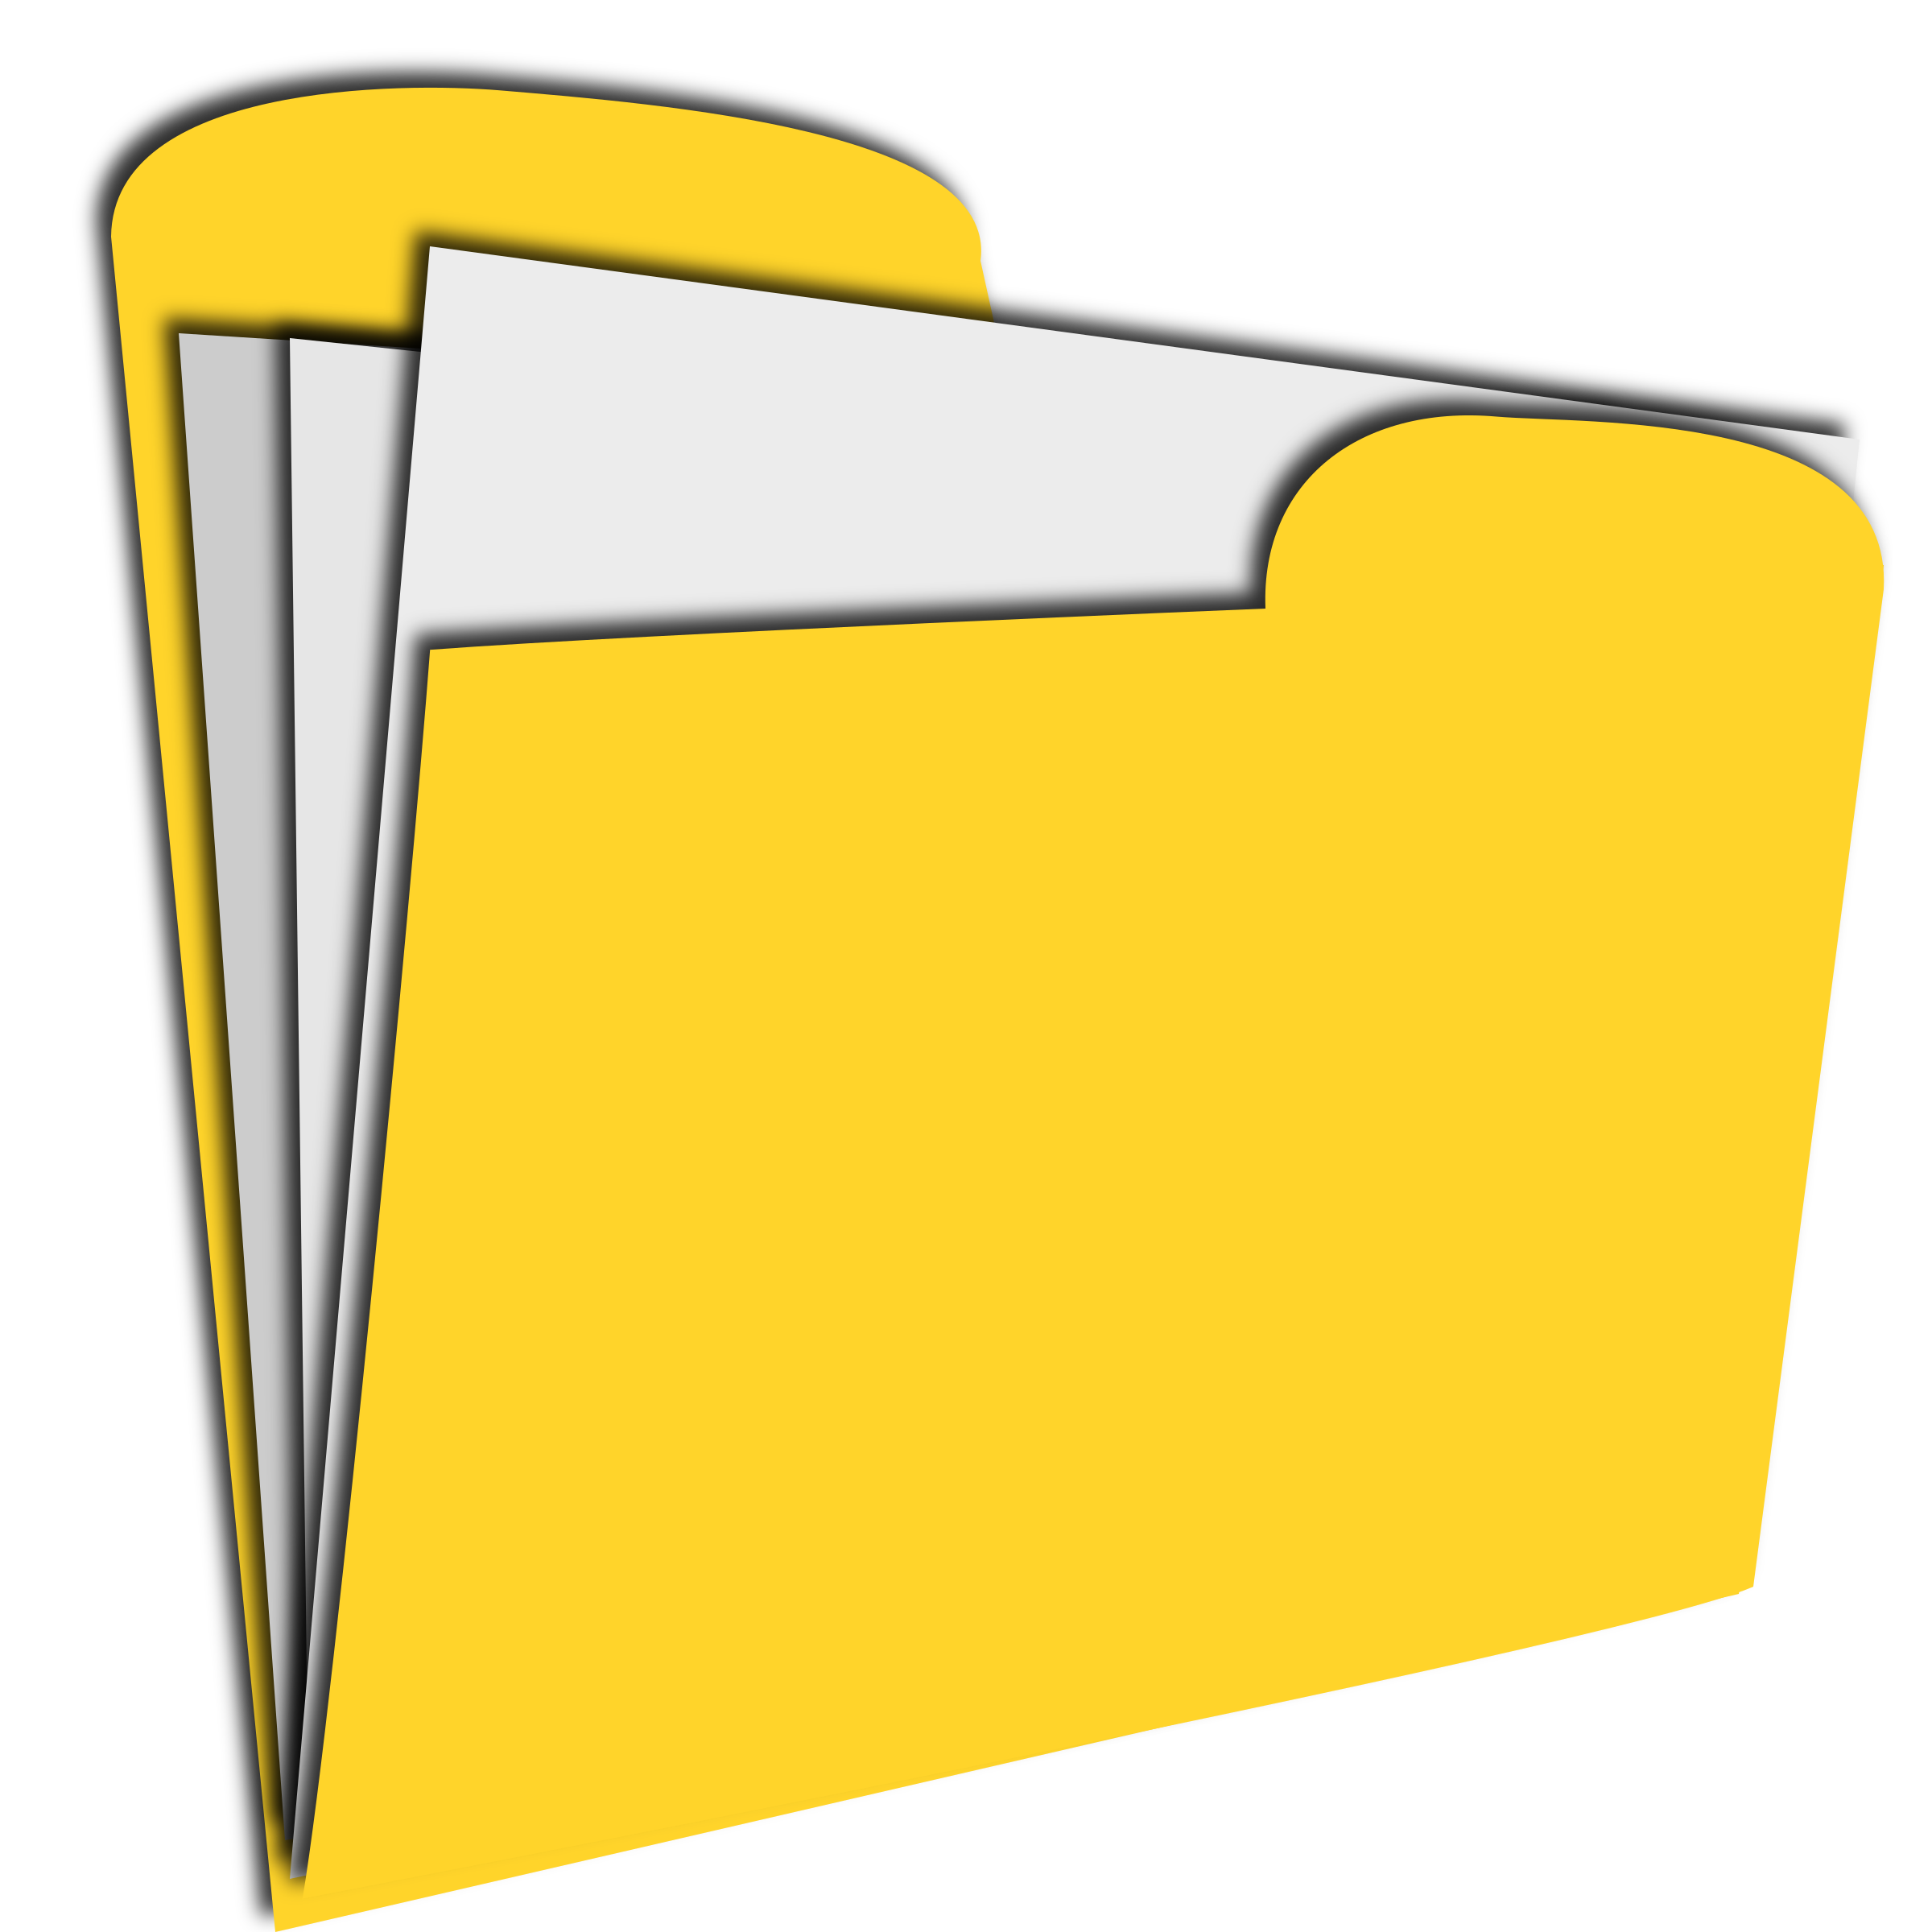
Traditional Computer Storage
Hard Drive
Notes:
You are a person
You have a computer. This computer is in your house or at your office.
You use this computer to make some files. Business reports, or a list of family addresses. Your daughter uses the computer to type a paper for school. Your son uses this to save pictures.
Now, we want these documents and photos to be saved so that we can access them later. So, we save them to the computer.
Hard Drive – internal storage of the computer. The only place this data that we saved is located is on the computer hard drive. So, we need to be on this computer to access it.
This type of storage is still very much around, but as we go through this we’ll start to see its limitations, so we can see why other options have developed.
Let’s look at another example

Slide 4
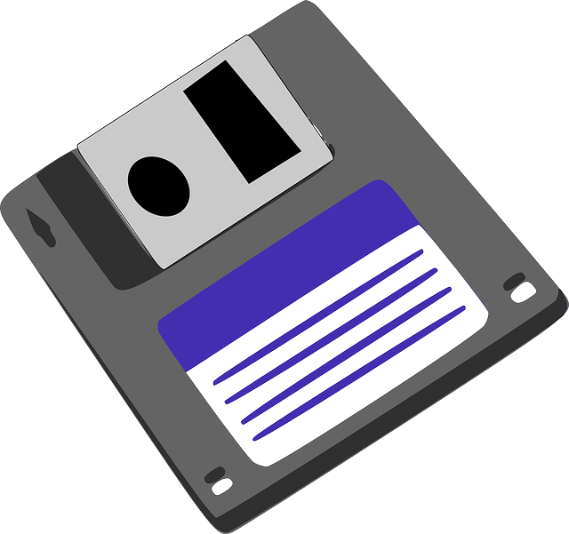
Traditional Computer Storage
External Drive
Hard Drive
Notes:
Same situation. You are a person and you have a computer. This computer is in your house or at your office.
You use this computer and you make some files. But now your daughter wants to work on her paper while she’s at the library. You can’t take your computer to the library. So, what we need to do is save this to an external device.
An external device can be a number of things. But basically it’s a physical object that stores data. Cd rom, floppy disk, usb drive, external hard drive.
So now, we have this report on the computer hard drive and the external device. So we should be noticing some very clear benefits to this idea. If something happens to the computer, the file is still on the external device. If I’m somewhere else I can still work on my paper. We may also be noticing some drawbacks which we’ll talk about soon.
Let’s extrapolate this idea a little more

Slide 5
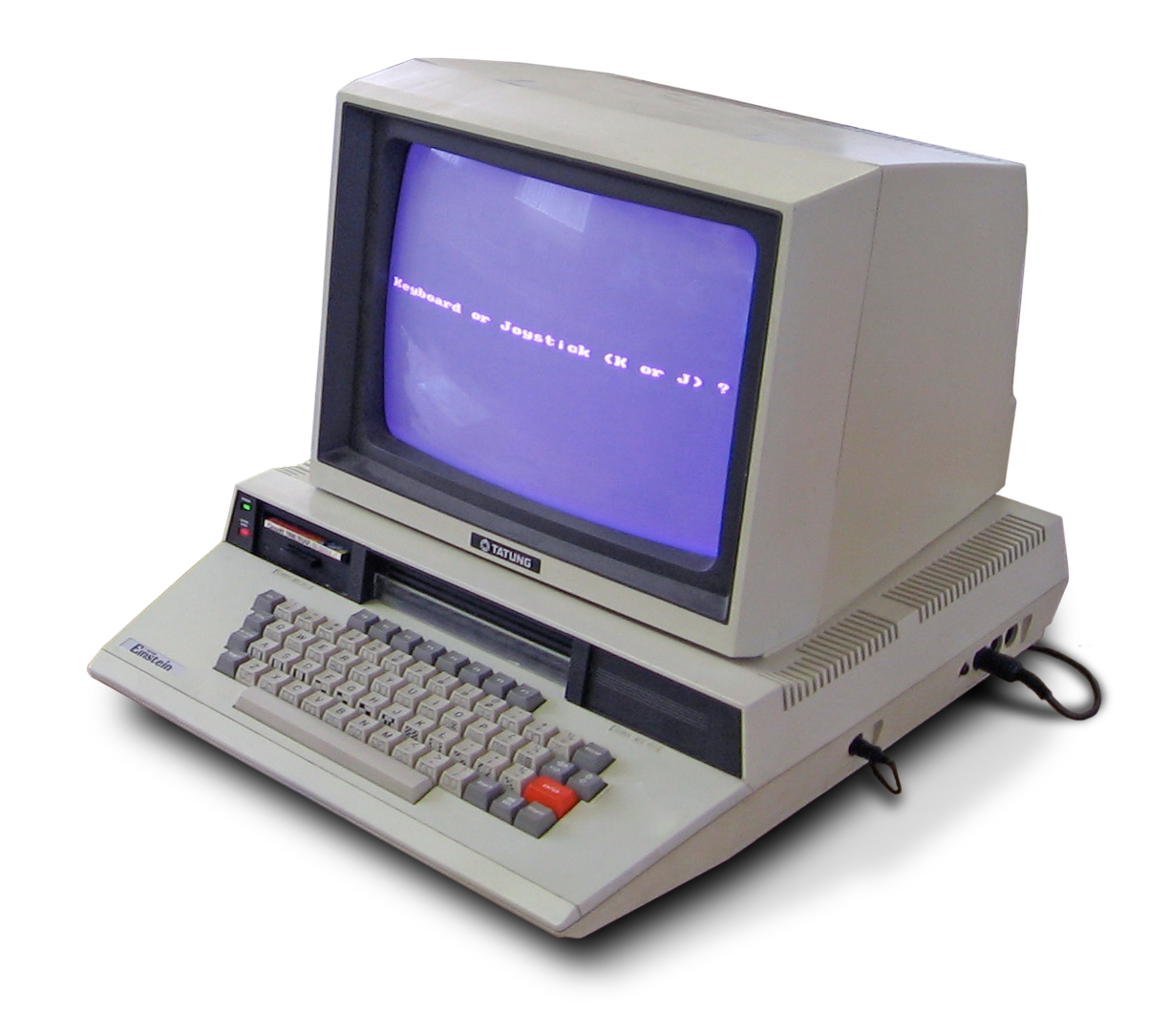
Traditional Computer Storage
Notes:
So you’ve got your computer at home or in your office and you can do this. But now, your friend has their own computer at home and their daughter is working on the same paper. And another classmate has the same thing.
So for the most part, this is the way computer storage worked for a long time.
Now let’s get in to what cloud storage is

Slide 6
Cloud storage
Cloud storage is a system of storage where a user saves data remotely with the ability to access the data through the Internet
Notes:
U.S. Department of Defense, ARPANET, a.k.a., the Advanced Research Projects Agency Network, became the first viable way to send data through packets.

Slide 7
Cloud storage is a system of storage where a user saves data remotely with the ability to access the data through the Internet
Notes:
This person is our user.
They work on the computer and they create their data. Data here can mean any of the documents, photos, or other things we create on a computer.
Save remotely – this means it’s saved somewhere other than the computer
Ability to access data through the internet – we can get to that data
So – in one regard this is very similar to an external storage device, right? You make something on a computer and you save it somewhere else. The key to cloud storage is this final part about access data through the internet. This becomes the key to cloud storage. And again, this is going to show us some benefit and some drawbacks.

Slide 8
Cloud storage
Concept is not new
ARPANET(1960) / DotCom Boom (1990) / Amazon Web Services (2002)
EMAIL
Applications are expanding
Backup insurance (Carbonite/Mozy)
Personal storage - Google Drive/iCloud and more
Notes:
Cloud storage is a modern term that’s becoming mainstream
However, the concept is not new
U.S. Department of Defense, ARPANET, a.k.a., the Advanced Research Projects Agency Network, became the first viable way to send data through packets. So they realized that a system where data is only locally stored on individual computers was not efficient for collaboration and team work.
Email –
How many people have email?
How many people have checked their email on a computer other than your home computer?
This is the concept of cloud storage. We don’t think of it that way because we’re trained to think of EMAIL as just existing on the internet. But really, what’s happening is that your email provider has storage space on the internet and is just holding everything there so that you can get to it.
So the concept is not new, but some of the ways it’s being used are new.
One of the first commercial applications was for backup insurance for deletion, viruses, physical damage. Technology is a business, so someone thought, how can we leverage this into a product we can sell.
Carbonite and Mozy were 2 big companies who did this.
The next application that’s become a viable product is personal storage space. Think of the ways we created 20 years ago and before that. Typewriters, polaroids, we wrote letters. Im old enough to have written my grade school essays by hand. In high school and college I started using a computer. So as we’ve moved toward an environement where we create more and more digital assets, it makes sense that we need a place to store these.
Camera phones. We have the ability to fill massive amounts of space with something in our pocket. Products like Google Drive and iCloud which we’ll talk about are answers to questions like what do we do with all our camera photos.

Slide 9
Cloud storage 101
Benefits/drawbacks

Slide 10
Cloud Storage
Benefits to Cloud Storage
Convenience/Access
Emergency/Backup
Low cost – free to a certain limit
Notes:
Convenience and Access –
This should be the obvious one as we’ve gone through some of the scenarios. Cloud storage removes the logistical problems and limitations by making data easily and readily available. Think of professions where it’s common to work from home or on the road.
Emergency – A good rule of thumb for computer storage is to have 2 backups of any important material. Ideally you want these backups to be in different formats, too. So, cloud storage is often used as one of these formats. The other format is a physical copy on an external storage device
Low Cost – as technology advances, things usually get more affordable. Cloud storage is at a pretty comfortable price point right now for consumers. Plus, with major tech players involved, there will be competitive pricing.
in 1967, a 1-megabyte hard drive would have set you back by $1 million.
Today, that same megabyte of capacity on a hard disk drive (HDD) costs about two cents.

Slide 11
Cloud Storage
Drawbacks to Cloud Storage
Reliant on more* factors outside your control
Get stuck with a service
Long term costs
Notes:
A lot of these drawbacks are just the flip side to the advantages.
Outside your control – let’s say you have a presentation and you save it to a flash drive. To give that presentation in new York, you’re reliant on you bringing the flash drive. If you’re using a cloud storage service to give the presentation you’re reliant on that system not experience any problems.
I say more because technology is inherently dependent on factors outside your control. But this adds an extra layer.
If you’re using cloud storage and their system gets erased, you don’t have your files anywhere else, If you’re using the cloud and you don’t have internet, you might not get your files
When you buy an iphone, you’re set up with an icloud account. They want you to start using their systems as much as possible. It can be challenging to decide you want to move away from a storage service to another one and ensure everything is transferred correctly.
Yes, rates are affordable now, but it’s not yet a one-time purchases. You’re continuing to rent “”internet space”” And as we should now from economics, renting is always expensive in the long run.
That’s a cloud storage 201 class – but there are ways to build your own server.
Rates may raise over time and if you’re tied to that system, it’ll be hard to get away from it.

Slide 12
Cloud storage 101
Basics of use

Slide 13
Traditional Computer Storage
Notes:
So we went over this process before. External device used to save material.
The same idea applies to cloud services. Here’s how it looks.

Slide 14
CLOUD Computer Storage
Notes:
Each user is creating data on their computer and they are saving it to the cloud.

Slide 15
Cloud Computer Storage
Notes:
These are individual clouds inside the bigger cloud.
So, the technical ability to get in the cloud is available to anyone. The cloud is just the internet. But it is made up of millions of applications and users taking advantage of it for their own usage. Millions of locks and doors.
Think of the big cloud as a huge hotel and you have a key that gets you in the door. So you can go to some public areas like the lobby and the pool. This is your email and some social media. But you also have a key to your room. And no one else can get in that room. That’s your personal cloud storage.

Slide 16
Cloud Storage
Notes:
Here’s another way to visualize it. All computers that are connected to the internet have access to this cloud. But each user can have smaller clouds that they use for their own stuff.

Slide 17
Getting to Your Cloud
Account
Username/Password
Notes:
So now let’s dig in to how we get to our own personal cloud.
We talked a little bit about email before
So your email is a specific type of cloud storage. How do you get to your email? How do you make sure it’s your email you’re seeing and not someone else’s?
You have a specific account. That accounts requires you to log in with a username and password

Slide 18
Cloud Computer Storage
Notes:
If you are a user, there’s the entire cloud for you to use. Depending on what services you use, you’ll have different ways to get to your data.
It’s very possible you may have different keys to get to different data.
You’re already doing this – Facebook account – Banking account – email account.

Slide 19
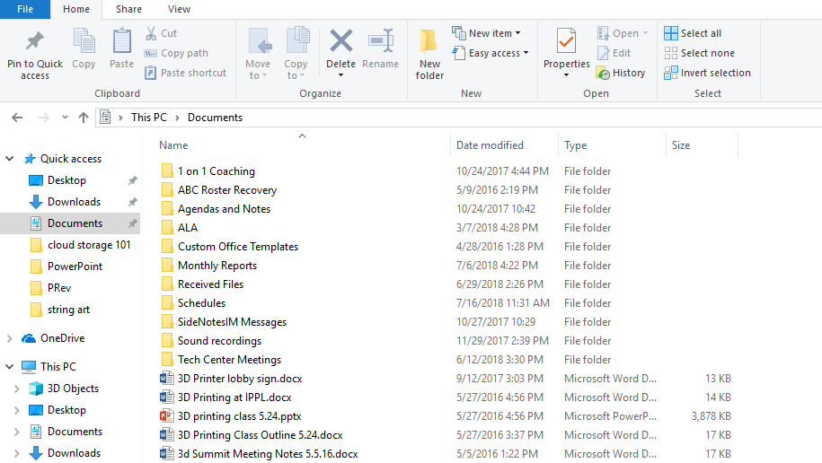
Cloud Computer Storage
Notes:
So what does the room look like once you’re in there?
It mimics traditional file storage interfaces.
Heirarchy of files and folders

Slide 20
Cloud Computer Storage
Model of Service
Freemium
Hook you to convenience and routine
Notes:
Most of the services I’m going to get into have the same model of service
Freemium is a combination of Free and Premium. It’s a popular model for a lot of apps and websites. It means you get something from free, but there are upgrade packages available that will cost you more money. A lot of times this model is used to remove ads. So, Pandora and Spotify are music services you can sign up for and listen to music. But, there are ads that play between songs. If you want to get rid of those ads, you’ll have to sign up for a premium account which costs money.
For cloud storage, the thing they’re selling is storage space. So in the freemium model it’s a small amount of space for free, and to buy more space that will cost you an upgrade to a premium model.
The more you use a specific service, the more likely you are to stay with that service if your needs expand.

Slide 21
Cloud storage 101
Major services

Slide 22
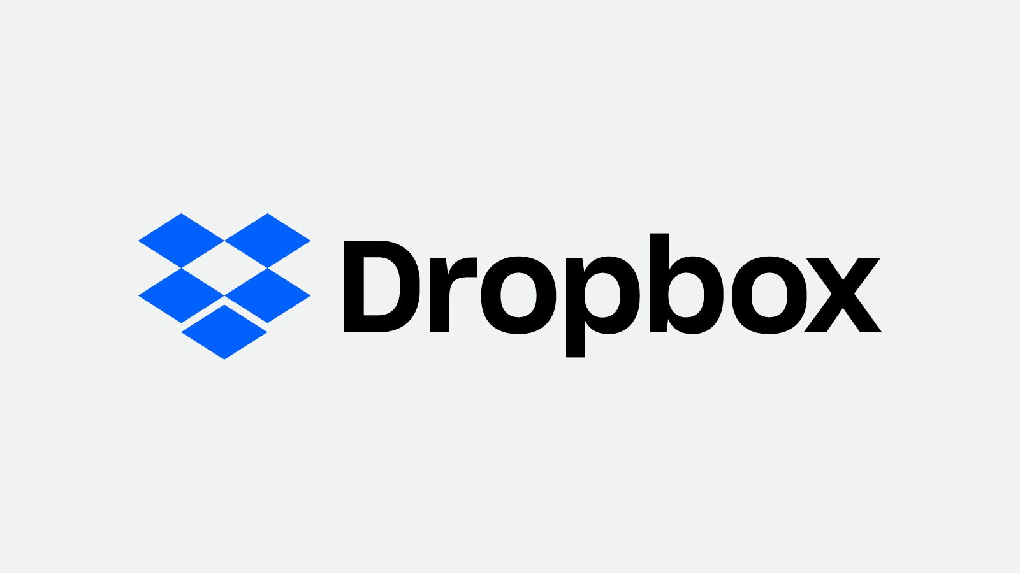
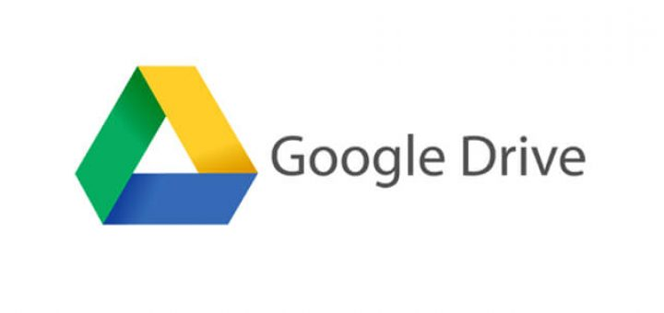
services
Notes:
These are the 4 major cloud storage services for personal use
You’re going to hear a lot of numbers in the next couple of slides. The chart handout does a good job of laying that out. Remember, the basics are all the same. You get a certain amount for free, and you can pay for more.
You are certainly free to open accounts with all of these services, too. One caution, the more places you have stuff, the harder it can be to manage. Multiple logins and passwords.

Slide 23
Dropbox
Free Tier
$
$$$
2 GB
1 TB
1 TB/support & features
0
99/year
199/year
Notes:
If you’re using cloud storage and their system gets erased, you don’t have your files anywhere else, If you’re using the cloud and you don’t have internet, you might not get your files
It can be hard to get your information out of Google
Rates may raise over time and if you’re tied to that system, it’ll be hard to get away from it.
Ultimately – cloud storage is worth it, but its not the only solution.

Slide 24
Geared toward Businesses
Desktop Sync
Notes:
Desktop sync tries to make saving a seamless process. While you’re working on files on your computer, theres a desktop version of dropbox that grabs what you save and updates your cloud.
Great for collaboration and a mobile office
Not perfect for users just looking to store some photos

Slide 25
Google Drive
15 GB (includes email)
100 GB
200 GB
Free Tier
$
$$$
0
1.99/month
2.99/month
Notes:
If you’re using cloud storage and their system gets erased, you don’t have your files anywhere else, If you’re using the cloud and you don’t have internet, you might not get your files
It can be hard to get your information out of Google
Rates may raise over time and if you’re tied to that system, it’ll be hard to get away from it.
Ultimately – cloud storage is worth it, but its not the only solution.

Slide 26
Suite of Google Products
Email, photos, calendar
Most space in the free model
Notes:
So I talked about getting hooked to convenience. This is what Google does.
Because I use gmail, ive become accustomed to using that as my work base. For me, Google drive is a good place to have files and copies of documents I need. Resumes

Slide 27
One Drive
Free Tier
$
$$$
5 GB
50 GB
1 TB/office 365
0
1.99/month
69.99/year
Notes:
One Drive is Microsoft’s product.

Slide 28
Includes Microsoft Office 365
Work environment

Slide 29
Storage Space
1000 KB = 1 MB 1000 MB = 1 GB
1 Microsoft Word document = 10 KB
5 GB = 500,000 Word documents
1 Smart phone photo / 1 MP3 song = 5 MB
5GB = 1,000 photos or songs
1 min of smart phone video = 50MB
5GB = 100 short videos
Notes:
What weighs more a pound of feathers or a pound of bricks?
So the question here is, how much can you save on 5 GB of space?
It all depends on what you’re saving.
Text is easy to store. Pictures and video are harder.
PDFs may be small, but they could be really large, too.
A freelance photographer is going to need a lot more space for the pictures from a camera. We don’t need as much space for our iphone pictures.

Slide 30
Icloud
Free Tier
$
$$$
5 GB
50 GB
200 GB
0
0.99/ month
2.99/month
Notes:
If you’re using cloud storage and their system gets erased, you don’t have your files anywhere else, If you’re using the cloud and you don’t have internet, you might not get your files
It can be hard to get your information out of Google
Rates may raise over time and if you’re tied to that system, it’ll be hard to get away from it.
Ultimately – cloud storage is worth it, but its not the only solution.

Slide 31
Cloud storage 101
Quick tour

Slide 32
Some questions to consider
What do you need the space for?
Backup or something you'll use often?
What products do you work in - Office, Google Docs, Pages, etc.?
Time and energy vs. costs?

Slide 33
Cloud storage 101
questions
Notes:
What we’ll cover today – where did cloud storage come from? how has computer storage evolved
Some of the benefits and issues to be aware of
How are most of these storage sites used
What are my options for using cloud storage right now
What does it look like in use

