Slide 1
Photo Restoration with Adobe Photoshop
Tips & Tricks
Kathleen Weiss

Slide 2
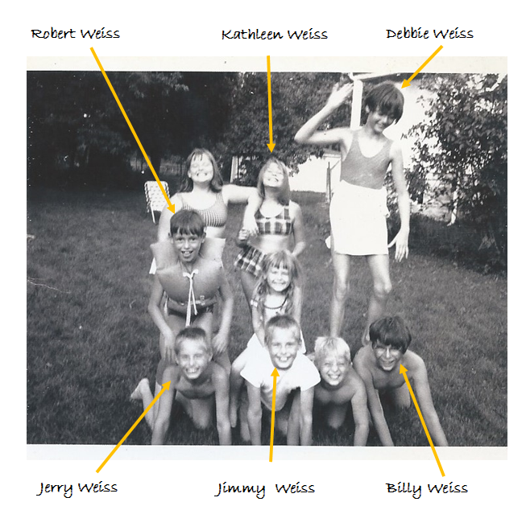
Before you begin
Identify each person in every photo.

Slide 3
Before you begin
Establish an organizational system for your prints.

Slide 4
Before you begin
Establish an organizational system for the digital photos that includes a file naming scheme.

Slide 5
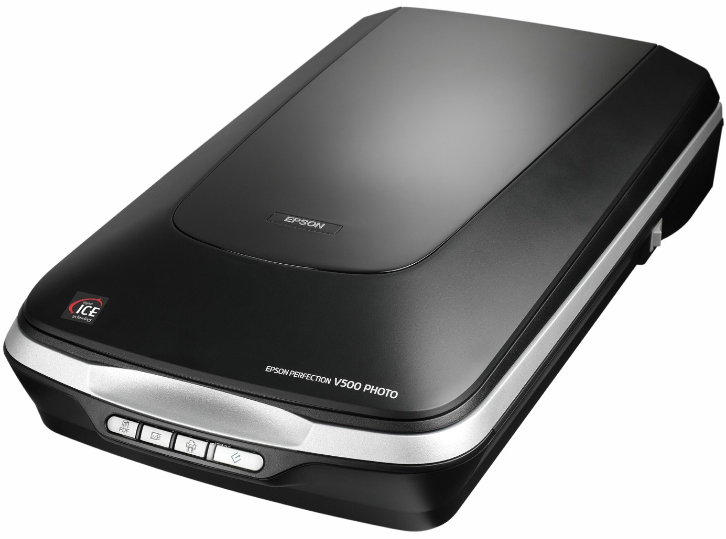
Before you begin
Scan your photos, slides, and negatives with a high quality scanner at a minimum of 600 dpi.

Slide 6
No scanner? No problem!
Use the Launch Pad!
The Launch Pad has three rooms available for ITPL cardholders by appointment.
Cardholders can access scanners and the software we’ll discuss in class today.
Reservations may be made by calling the library at 847-459-4100

Slide 7
Best Practices
Make a separate copy of your original digital file for editing purposes.

Slide 8
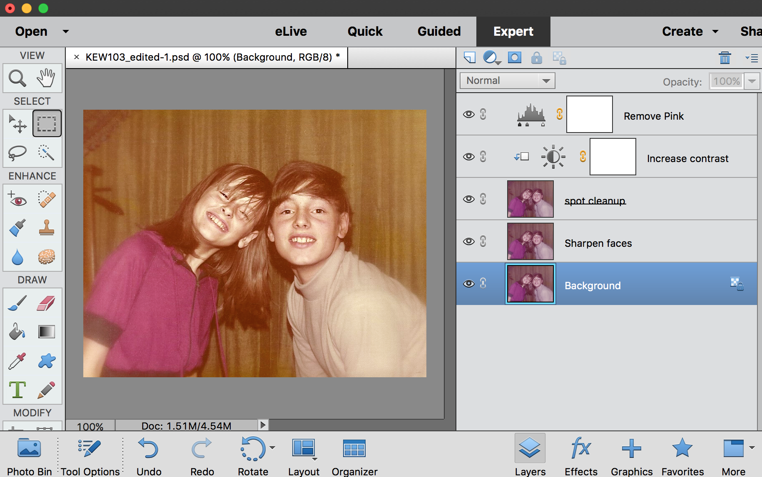
Best Practices
Edit non-destructively and create a separate named layer for each edit.
*Sample all layers when editing

Slide 9
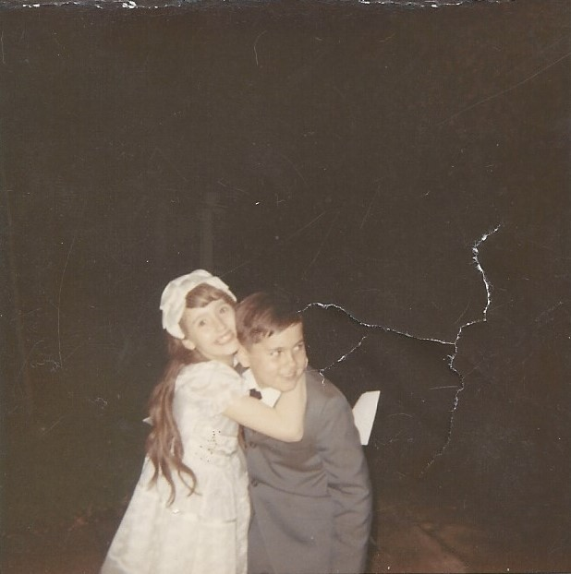
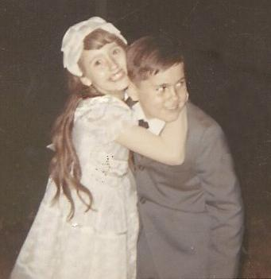
Best Practices
Crop out excess to avoid retouching any unnecessary areas.

Slide 10
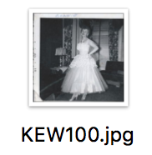
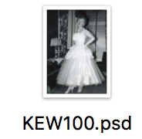
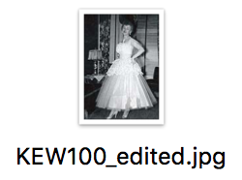
Best Practices
Original
Keep a copy of your original , a Photoshop copy (.psd), and a final edited version.
Photoshop
Edited

Slide 11
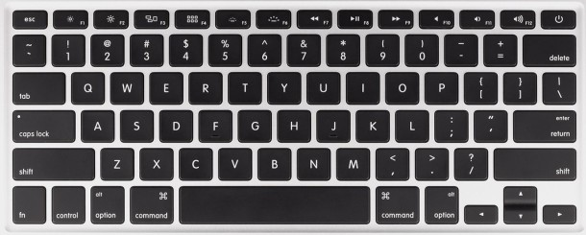
Best Practices
Use the bracket keys [ ] on your keyboard to quickly increase or decrease the size of your brush.

Slide 12
Best Practices
Don’t zoom in more than 200% when making corrections. You’ll “over edit” and waste time.

Slide 13
Tools of the Trade
Crop
Where is it? Click on the Crop icon from the Toolbar.
What does it do? Crop is used to remove portions of a photo to create focus or strengthen the composition. This is useful for removing unnecessary parts or content from a photo.

Slide 14
Tools of the Trade
Straighten
Where is it? Click on the Crop icon from the Toolbar. Click on the Straighten icon in the top menu.
What does it do? This tool straightens the photo on a designated horizon line and is useful for correcting tilt.

Slide 15
Tools of the Trade
Spot Healing Brush
Where is it? Click on the Spot Healing Brush icon from the Toolbar
What does it do? The Spot Healing Brush samples the pixels near its edge and then uses them to replace the pixels inside the brush. This is useful for removing wrinkles, dust, and blemishes.

Slide 16
Tools of the Trade
Healing Brush
Where is it? Right-click on the Spot Healing Brush icon from the Toolbar. From the fly out menu, click the Healing Brush.
What does it do? The Healing Brush replaces pixels in one area with sampled pixels from another and melds their textures together. This is useful for removing wrinkles, dust, and blemishes.

Slide 17
Tools of the Trade
Clone Stamp
Where is it? Click the Clone Stamp icon from the Toolbar.
What does it do? Clone Stamp creates a stamp by sampling pixels from another part of an image. These pixels are placed on other areas of the photo. This is useful for removing wrinkles, dust, and other blemishes.

Slide 18
Tools of the Trade
Sharpen
Where is it? Right-click the Blur icon from the Toolbar. From the Tool flyout menu, click the Sharpen icon.
What does it do? Sharpen increases the contrast between lines in your photo. This is useful for revealing details or creating contrast in blurred area of photos such as faces.

Slide 19
Tools of the Trade
Burn
Where is it? Right-Click the Sponge icon from the Toolbar. From the fly out menu, click the Burn icon.
What does it do? Burn used to add shadows to a photo. This is useful for increasing shadows in sections a of a photo.

Slide 20
Tools of the Trade
Adjustment Layers
Where is it? From the menu choose Layer > New Adjustment Layer > Choose Type > Choose type of adjustment layer.
What does it do? Adjustment layers act like a filter for your photo allowing you to adjust brightness/contrast, levels, hue/saturation, and much more.

Slide 21
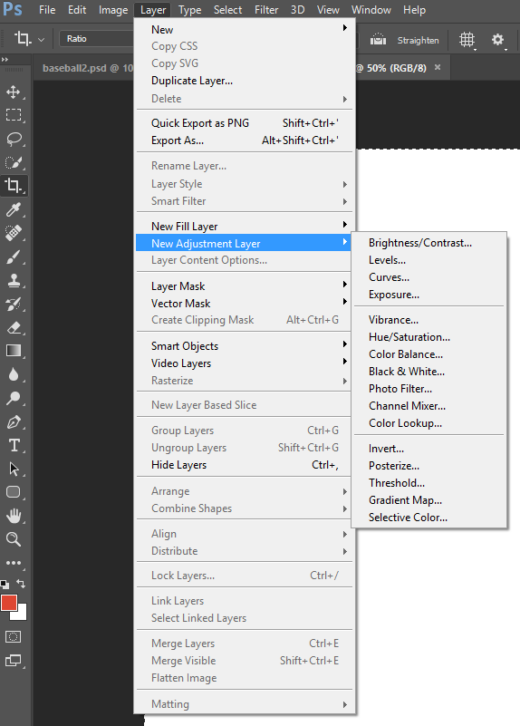
Tools of the Trade
Adjustment Layers
Where is it? From the menu choose Layer > New Adjustment Layer > Choose Type > Choose type of adjustment layer.
What does it do? Adjustment layers act like a filter for your photo allowing you to adjust brightness/contrast, levels, hue/saturation, and much more.

Slide 22
Let’s get started...
Open Adobe Photoshop.
From the menu choose Open > Select your photo > Choose open.

