Slide 1
LinkedIn Basics
Niles-maine district library

Slide 2
Resources
Make a one-on-one appointment with a LinkedIn specialist via our Job Counseling program by calling 847-663-6603. Help is available on the first Wednesday of every month.
Brainfuse offers professional resume reviews, job coaching, and practice with interview skills. Access Brainfuse at www.nileslibrary.org > Resources > For Job Seekers > Brainfuse
Lynda.com offers over 100,000 tech course at all skill levels. Access Lynda.com at www.nileslibrary.org > Resources > For Job Seekers > Lynda.com
LinkedIn books are available for check out under the following call number: 650.1302
Book one-on-one tech help by calling 847.663.6606
Notes:
How presentation will benefit audience: Adult learners are more interested in a subject if they know how or why it is important to them.
Presenter’s level of expertise in the subject: Briefly state your credentials in this area, or explain why participants should listen to you.

Slide 3
Agenda
About LinkedIn
Terms
The Toolbar
Home
Me > Profile
My Network
Jobs
Search Box
Notes:
Review agenda with participants so they know what to expect. Ask them to hold their questions until you review all the features, in case it’s part of the agenda.

Slide 4
About LinkedIn

Slide 5
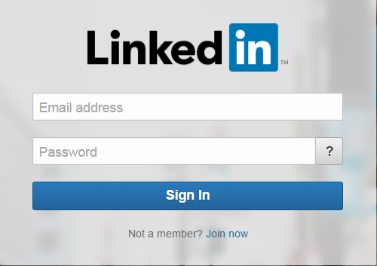
About LinkedIn
www.linkedin.com
Launched in 2003
Over 300 million users in 200 countries
Social networking site designed to help professionals connect
Notes:
Timeframe: 5 minutes
Explain that LinkedIn is a global network of business professionals with over 300 million users in over 200 countries.
Share that the purpose of LinkedIn is to allow people in like industries and companies to connect, share information and recruit talent for jobs and projects.
Discuss that Home page is the place where users are notified of what’s going on in their circles (like articles, notifications, suggested jobs, groups, and connections).
Share that Profile page is the area where folks build their online “resume,” and that it includes many category options, depending on how detailed folks want to be.
Explain that a Connection is someone to whom the user has linked his or herself and that as a result, they are able to see each other’s information, write recommendations, endorse each other and other activities (like a “Friend” on Facebook). Explain that there are 3 levels of connection- 1st (1:1 connection), 2nd (connection of a connection), and 3rd (connection of a connection of a connection). Share that this can be useful in building a professional network.
Highlight that an Introduction is a tool for getting connected with a 2nd or 3rd level connection.
Discuss that one of the most powerful tools in LinkedIn is the Recommendation feature, which allows users to write online recommendations for one another that are visible on their profiles. Share that recruiters use this ALL THE TIME as a way to screen job candidates.
Explain that the Jobs section allows users to search for open positions in their industries and in many cases, apply directly from LinkedIn.
Share that the Interests section allows users to get information on companies and organizations, follow them, and join groups.

Slide 6
Terms

Slide 7
Terms
The Toolbar: The stationary bar used to navigate between different areas of LinkedIn.
Notes:
Timeframe: 5 minutes
Explain that LinkedIn is a global network of business professionals with over 300 million users in over 200 countries.
Share that the purpose of LinkedIn is to allow people in like industries and companies to connect, share information and recruit talent for jobs and projects.
Discuss that Home page is the place where users are notified of what’s going on in their circles (like articles, notifications, suggested jobs, groups, and connections).
Share that Profile page is the area where folks build their online “resume,” and that it includes many category options, depending on how detailed folks want to be.
Explain that a Connection is someone to whom the user has linked his or herself and that as a result, they are able to see each other’s information, write recommendations, endorse each other and other activities (like a “Friend” on Facebook). Explain that there are 3 levels of connection- 1st (1:1 connection), 2nd (connection of a connection), and 3rd (connection of a connection of a connection). Share that this can be useful in building a professional network.
Highlight that an Introduction is a tool for getting connected with a 2nd or 3rd level connection.
Discuss that one of the most powerful tools in LinkedIn is the Recommendation feature, which allows users to write online recommendations for one another that are visible on their profiles. Share that recruiters use this ALL THE TIME as a way to screen job candidates.
Explain that the Jobs section allows users to search for open positions in their industries and in many cases, apply directly from LinkedIn.
Share that the Interests section allows users to get information on companies and organizations, follow them, and join groups.

Slide 8
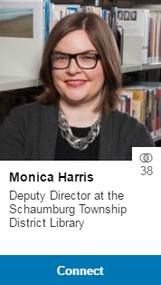
Terms
Connections: Professional contacts to whom you’re directly connected
Potential Connections:
Connections of Connections
Notes:
Timeframe: 5 minutes
Explain that LinkedIn is a global network of business professionals with over 300 million users in over 200 countries.
Share that the purpose of LinkedIn is to allow people in like industries and companies to connect, share information and recruit talent for jobs and projects.
Discuss that Home page is the place where users are notified of what’s going on in their circles (like articles, notifications, suggested jobs, groups, and connections).
Share that Profile page is the area where folks build their online “resume,” and that it includes many category options, depending on how detailed folks want to be.
Explain that a Connection is someone to whom the user has linked his or herself and that as a result, they are able to see each other’s information, write recommendations, endorse each other and other activities (like a “Friend” on Facebook). Explain that there are 3 levels of connection- 1st (1:1 connection), 2nd (connection of a connection), and 3rd (connection of a connection of a connection). Share that this can be useful in building a professional network.
Highlight that an Introduction is a tool for getting connected with a 2nd or 3rd level connection.
Discuss that one of the most powerful tools in LinkedIn is the Recommendation feature, which allows users to write online recommendations for one another that are visible on their profiles. Share that recruiters use this ALL THE TIME as a way to screen job candidates.
Explain that the Jobs section allows users to search for open positions in their industries and in many cases, apply directly from LinkedIn.
Share that the Interests section allows users to get information on companies and organizations, follow them, and join groups.

Slide 9
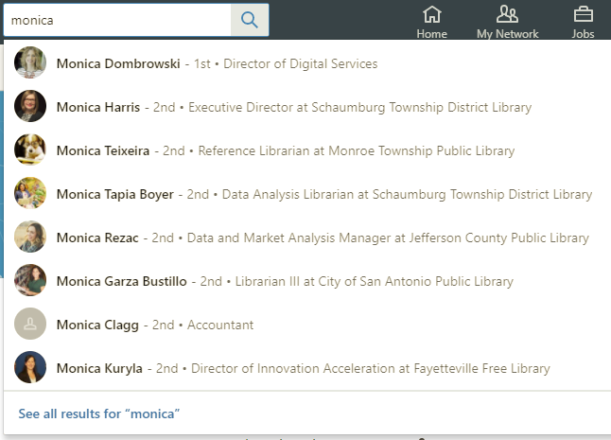
Terms
2nd Degree Connection: a connection of a connection
3rd Degree Connection: a connection of a 2nd degree connection
Notes:
Timeframe: 5 minutes
Explain that LinkedIn is a global network of business professionals with over 300 million users in over 200 countries.
Share that the purpose of LinkedIn is to allow people in like industries and companies to connect, share information and recruit talent for jobs and projects.
Discuss that Home page is the place where users are notified of what’s going on in their circles (like articles, notifications, suggested jobs, groups, and connections).
Share that Profile page is the area where folks build their online “resume,” and that it includes many category options, depending on how detailed folks want to be.
Explain that a Connection is someone to whom the user has linked his or herself and that as a result, they are able to see each other’s information, write recommendations, endorse each other and other activities (like a “Friend” on Facebook). Explain that there are 3 levels of connection- 1st (1:1 connection), 2nd (connection of a connection), and 3rd (connection of a connection of a connection). Share that this can be useful in building a professional network.
Highlight that an Introduction is a tool for getting connected with a 2nd or 3rd level connection.
Discuss that one of the most powerful tools in LinkedIn is the Recommendation feature, which allows users to write online recommendations for one another that are visible on their profiles. Share that recruiters use this ALL THE TIME as a way to screen job candidates.
Explain that the Jobs section allows users to search for open positions in their industries and in many cases, apply directly from LinkedIn.
Share that the Interests section allows users to get information on companies and organizations, follow them, and join groups.

Slide 10
Terms
Recommendations: Comments written by other LinkedIn members to recognize or commend you for your work
Notes:
Timeframe: 5 minutes
Explain that LinkedIn is a global network of business professionals with over 300 million users in over 200 countries.
Share that the purpose of LinkedIn is to allow people in like industries and companies to connect, share information and recruit talent for jobs and projects.
Discuss that Home page is the place where users are notified of what’s going on in their circles (like articles, notifications, suggested jobs, groups, and connections).
Share that Profile page is the area where folks build their online “resume,” and that it includes many category options, depending on how detailed folks want to be.
Explain that a Connection is someone to whom the user has linked his or herself and that as a result, they are able to see each other’s information, write recommendations, endorse each other and other activities (like a “Friend” on Facebook). Explain that there are 3 levels of connection- 1st (1:1 connection), 2nd (connection of a connection), and 3rd (connection of a connection of a connection). Share that this can be useful in building a professional network.
Highlight that an Introduction is a tool for getting connected with a 2nd or 3rd level connection.
Discuss that one of the most powerful tools in LinkedIn is the Recommendation feature, which allows users to write online recommendations for one another that are visible on their profiles. Share that recruiters use this ALL THE TIME as a way to screen job candidates.
Explain that the Jobs section allows users to search for open positions in their industries and in many cases, apply directly from LinkedIn.
Share that the Interests section allows users to get information on companies and organizations, follow them, and join groups.

Slide 11
The Toolbar

Slide 12
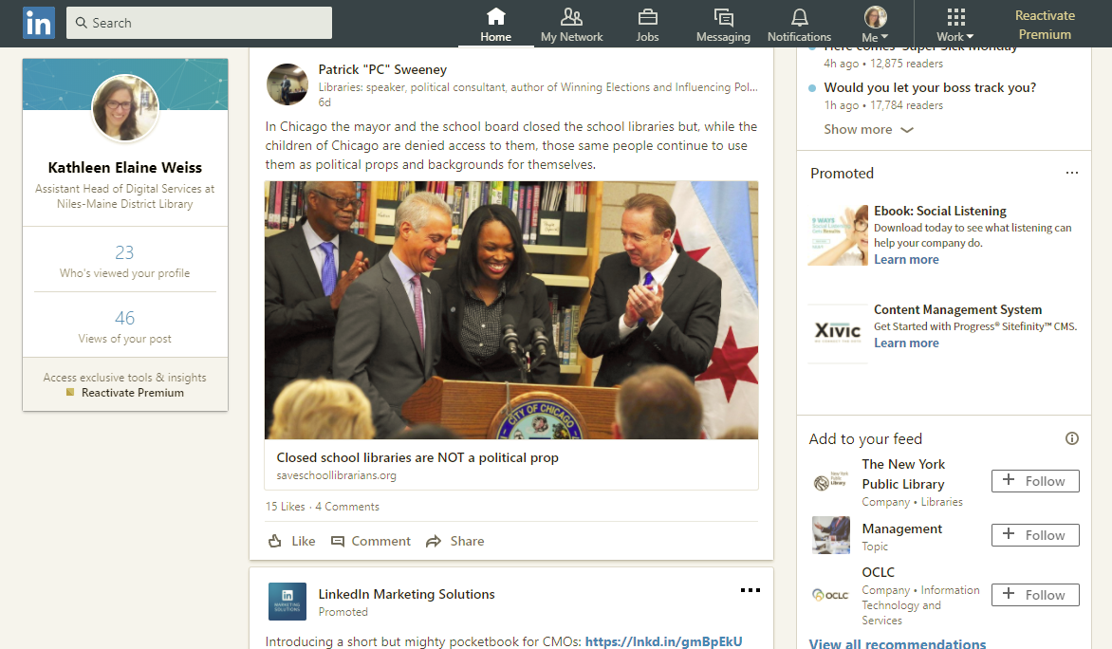
Toolbar
Notes:
Timeframe: 5 minutes
Explain that LinkedIn is a global network of business professionals with over 300 million users in over 200 countries.
Share that the purpose of LinkedIn is to allow people in like industries and companies to connect, share information and recruit talent for jobs and projects.
Discuss that Home page is the place where users are notified of what’s going on in their circles (like articles, notifications, suggested jobs, groups, and connections).
Share that Profile page is the area where folks build their online “resume,” and that it includes many category options, depending on how detailed folks want to be.
Explain that a Connection is someone to whom the user has linked his or herself and that as a result, they are able to see each other’s information, write recommendations, endorse each other and other activities (like a “Friend” on Facebook). Explain that there are 3 levels of connection- 1st (1:1 connection), 2nd (connection of a connection), and 3rd (connection of a connection of a connection). Share that this can be useful in building a professional network.
Highlight that an Introduction is a tool for getting connected with a 2nd or 3rd level connection.
Discuss that one of the most powerful tools in LinkedIn is the Recommendation feature, which allows users to write online recommendations for one another that are visible on their profiles. Share that recruiters use this ALL THE TIME as a way to screen job candidates.
Explain that the Jobs section allows users to search for open positions in their industries and in many cases, apply directly from LinkedIn.
Share that the Interests section allows users to get information on companies and organizations, follow them, and join groups.

Slide 13
Home Screen
Notes:
Timeframe: 5 minutes
Explain that LinkedIn is a global network of business professionals with over 300 million users in over 200 countries.
Share that the purpose of LinkedIn is to allow people in like industries and companies to connect, share information and recruit talent for jobs and projects.
Discuss that Home page is the place where users are notified of what’s going on in their circles (like articles, notifications, suggested jobs, groups, and connections).
Share that Profile page is the area where folks build their online “resume,” and that it includes many category options, depending on how detailed folks want to be.
Explain that a Connection is someone to whom the user has linked his or herself and that as a result, they are able to see each other’s information, write recommendations, endorse each other and other activities (like a “Friend” on Facebook). Explain that there are 3 levels of connection- 1st (1:1 connection), 2nd (connection of a connection), and 3rd (connection of a connection of a connection). Share that this can be useful in building a professional network.
Highlight that an Introduction is a tool for getting connected with a 2nd or 3rd level connection.
Discuss that one of the most powerful tools in LinkedIn is the Recommendation feature, which allows users to write online recommendations for one another that are visible on their profiles. Share that recruiters use this ALL THE TIME as a way to screen job candidates.
Explain that the Jobs section allows users to search for open positions in their industries and in many cases, apply directly from LinkedIn.
Share that the Interests section allows users to get information on companies and organizations, follow them, and join groups.

Slide 14
Search Box
Search for:
People
Jobs
Companies
Organizations
Universities
Notes:
Timeframe: 5 minutes
Explain that LinkedIn is a global network of business professionals with over 300 million users in over 200 countries.
Share that the purpose of LinkedIn is to allow people in like industries and companies to connect, share information and recruit talent for jobs and projects.
Discuss that Home page is the place where users are notified of what’s going on in their circles (like articles, notifications, suggested jobs, groups, and connections).
Share that Profile page is the area where folks build their online “resume,” and that it includes many category options, depending on how detailed folks want to be.
Explain that a Connection is someone to whom the user has linked his or herself and that as a result, they are able to see each other’s information, write recommendations, endorse each other and other activities (like a “Friend” on Facebook). Explain that there are 3 levels of connection- 1st (1:1 connection), 2nd (connection of a connection), and 3rd (connection of a connection of a connection). Share that this can be useful in building a professional network.
Highlight that an Introduction is a tool for getting connected with a 2nd or 3rd level connection.
Discuss that one of the most powerful tools in LinkedIn is the Recommendation feature, which allows users to write online recommendations for one another that are visible on their profiles. Share that recruiters use this ALL THE TIME as a way to screen job candidates.
Explain that the Jobs section allows users to search for open positions in their industries and in many cases, apply directly from LinkedIn.
Share that the Interests section allows users to get information on companies and organizations, follow them, and join groups.

Slide 15
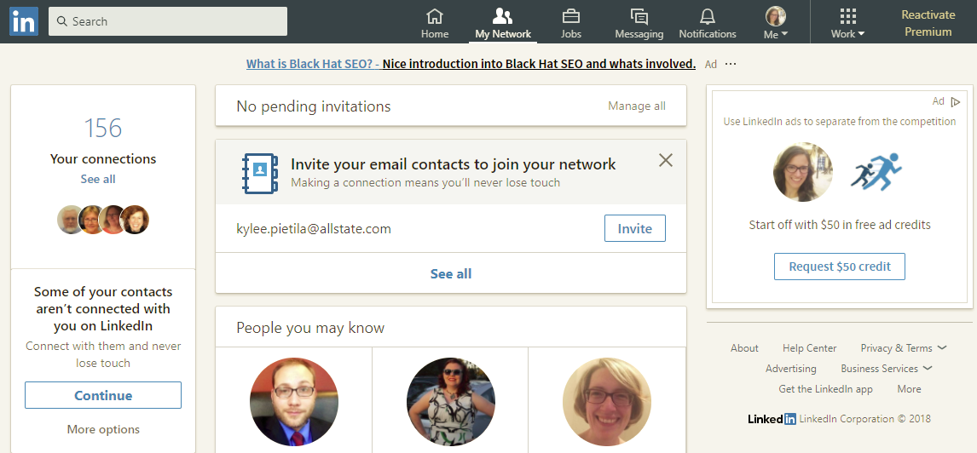
My Network
Notes:
Timeframe: 5 minutes
Explain that LinkedIn is a global network of business professionals with over 300 million users in over 200 countries.
Share that the purpose of LinkedIn is to allow people in like industries and companies to connect, share information and recruit talent for jobs and projects.
Discuss that Home page is the place where users are notified of what’s going on in their circles (like articles, notifications, suggested jobs, groups, and connections).
Share that Profile page is the area where folks build their online “resume,” and that it includes many category options, depending on how detailed folks want to be.
Explain that a Connection is someone to whom the user has linked his or herself and that as a result, they are able to see each other’s information, write recommendations, endorse each other and other activities (like a “Friend” on Facebook). Explain that there are 3 levels of connection- 1st (1:1 connection), 2nd (connection of a connection), and 3rd (connection of a connection of a connection). Share that this can be useful in building a professional network.
Highlight that an Introduction is a tool for getting connected with a 2nd or 3rd level connection.
Discuss that one of the most powerful tools in LinkedIn is the Recommendation feature, which allows users to write online recommendations for one another that are visible on their profiles. Share that recruiters use this ALL THE TIME as a way to screen job candidates.
Explain that the Jobs section allows users to search for open positions in their industries and in many cases, apply directly from LinkedIn.
Share that the Interests section allows users to get information on companies and organizations, follow them, and join groups.

Slide 16
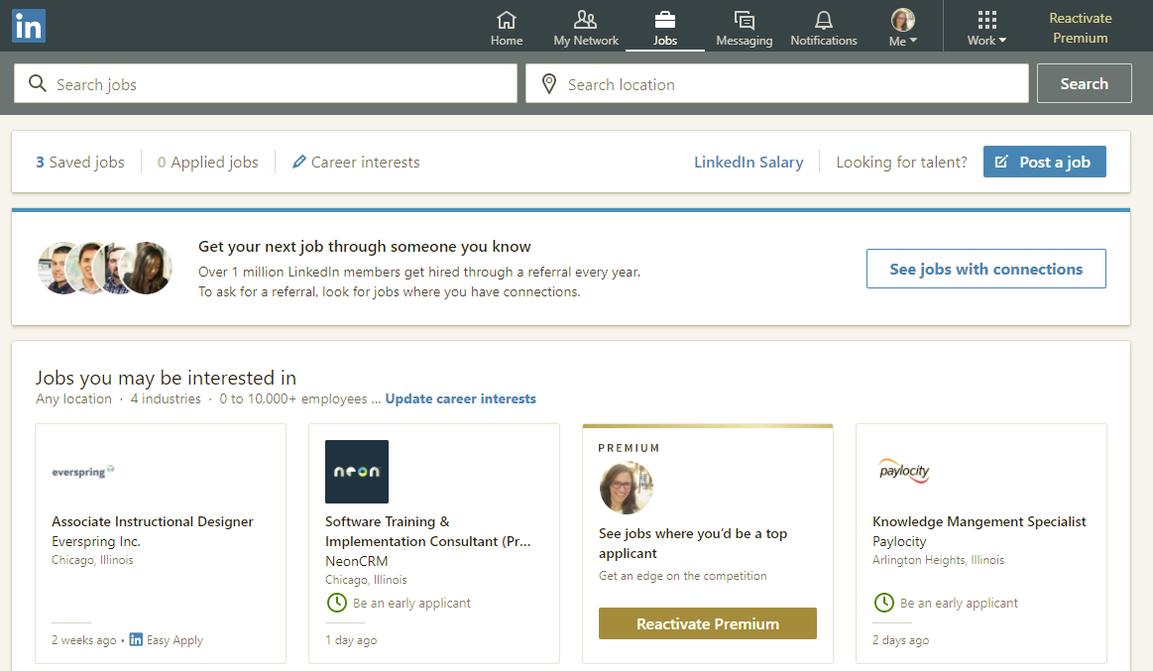
Jobs
Notes:
Timeframe: 5 minutes
Explain that LinkedIn is a global network of business professionals with over 300 million users in over 200 countries.
Share that the purpose of LinkedIn is to allow people in like industries and companies to connect, share information and recruit talent for jobs and projects.
Discuss that Home page is the place where users are notified of what’s going on in their circles (like articles, notifications, suggested jobs, groups, and connections).
Share that Profile page is the area where folks build their online “resume,” and that it includes many category options, depending on how detailed folks want to be.
Explain that a Connection is someone to whom the user has linked his or herself and that as a result, they are able to see each other’s information, write recommendations, endorse each other and other activities (like a “Friend” on Facebook). Explain that there are 3 levels of connection- 1st (1:1 connection), 2nd (connection of a connection), and 3rd (connection of a connection of a connection). Share that this can be useful in building a professional network.
Highlight that an Introduction is a tool for getting connected with a 2nd or 3rd level connection.
Discuss that one of the most powerful tools in LinkedIn is the Recommendation feature, which allows users to write online recommendations for one another that are visible on their profiles. Share that recruiters use this ALL THE TIME as a way to screen job candidates.
Explain that the Jobs section allows users to search for open positions in their industries and in many cases, apply directly from LinkedIn.
Share that the Interests section allows users to get information on companies and organizations, follow them, and join groups.

Slide 17
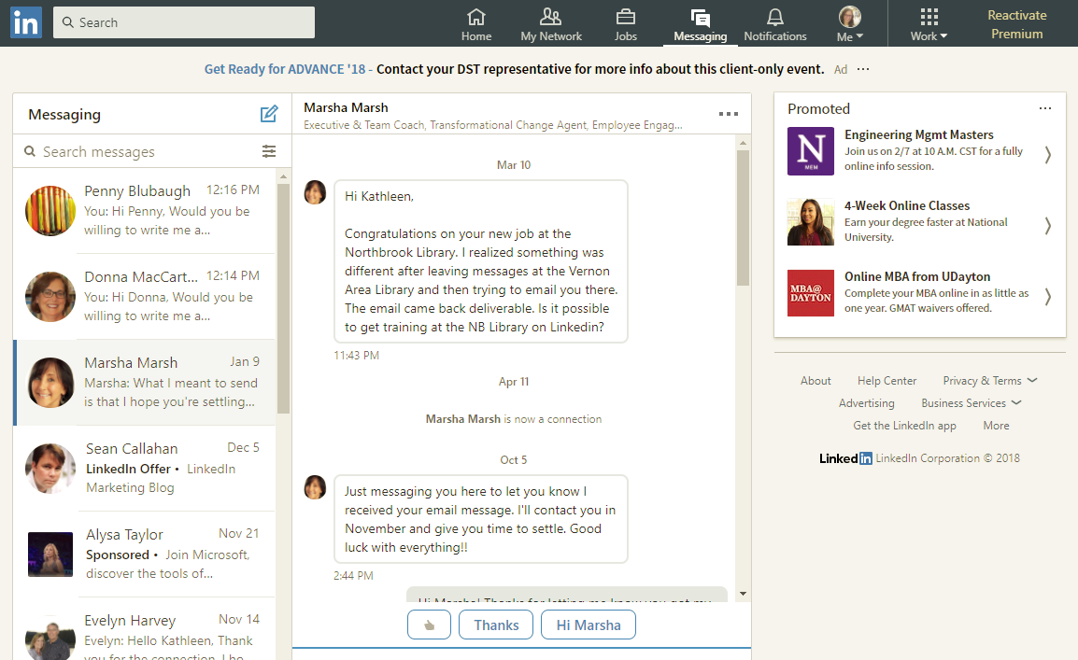
Messaging
Notes:
Timeframe: 5 minutes
Explain that LinkedIn is a global network of business professionals with over 300 million users in over 200 countries.
Share that the purpose of LinkedIn is to allow people in like industries and companies to connect, share information and recruit talent for jobs and projects.
Discuss that Home page is the place where users are notified of what’s going on in their circles (like articles, notifications, suggested jobs, groups, and connections).
Share that Profile page is the area where folks build their online “resume,” and that it includes many category options, depending on how detailed folks want to be.
Explain that a Connection is someone to whom the user has linked his or herself and that as a result, they are able to see each other’s information, write recommendations, endorse each other and other activities (like a “Friend” on Facebook). Explain that there are 3 levels of connection- 1st (1:1 connection), 2nd (connection of a connection), and 3rd (connection of a connection of a connection). Share that this can be useful in building a professional network.
Highlight that an Introduction is a tool for getting connected with a 2nd or 3rd level connection.
Discuss that one of the most powerful tools in LinkedIn is the Recommendation feature, which allows users to write online recommendations for one another that are visible on their profiles. Share that recruiters use this ALL THE TIME as a way to screen job candidates.
Explain that the Jobs section allows users to search for open positions in their industries and in many cases, apply directly from LinkedIn.
Share that the Interests section allows users to get information on companies and organizations, follow them, and join groups.

Slide 18
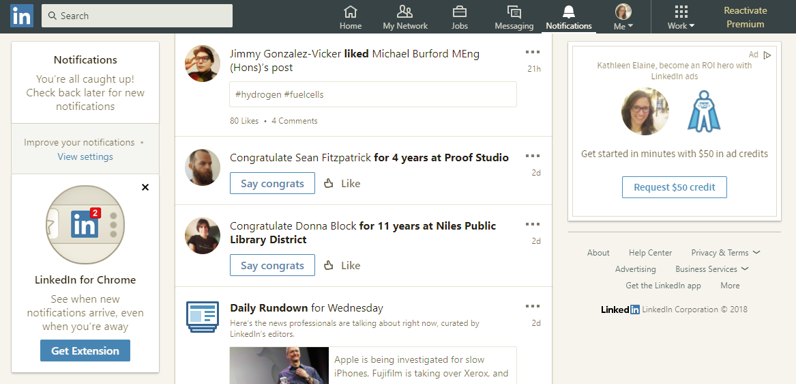
Notifications
Notes:
Timeframe: 5 minutes
Explain that LinkedIn is a global network of business professionals with over 300 million users in over 200 countries.
Share that the purpose of LinkedIn is to allow people in like industries and companies to connect, share information and recruit talent for jobs and projects.
Discuss that Home page is the place where users are notified of what’s going on in their circles (like articles, notifications, suggested jobs, groups, and connections).
Share that Profile page is the area where folks build their online “resume,” and that it includes many category options, depending on how detailed folks want to be.
Explain that a Connection is someone to whom the user has linked his or herself and that as a result, they are able to see each other’s information, write recommendations, endorse each other and other activities (like a “Friend” on Facebook). Explain that there are 3 levels of connection- 1st (1:1 connection), 2nd (connection of a connection), and 3rd (connection of a connection of a connection). Share that this can be useful in building a professional network.
Highlight that an Introduction is a tool for getting connected with a 2nd or 3rd level connection.
Discuss that one of the most powerful tools in LinkedIn is the Recommendation feature, which allows users to write online recommendations for one another that are visible on their profiles. Share that recruiters use this ALL THE TIME as a way to screen job candidates.
Explain that the Jobs section allows users to search for open positions in their industries and in many cases, apply directly from LinkedIn.
Share that the Interests section allows users to get information on companies and organizations, follow them, and join groups.

Slide 19
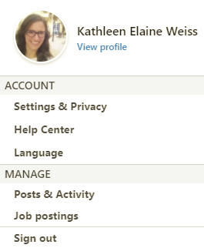
Me > View My Profile
Notes:
Timeframe: 5 minutes
Explain that LinkedIn is a global network of business professionals with over 300 million users in over 200 countries.
Share that the purpose of LinkedIn is to allow people in like industries and companies to connect, share information and recruit talent for jobs and projects.
Discuss that Home page is the place where users are notified of what’s going on in their circles (like articles, notifications, suggested jobs, groups, and connections).
Share that Profile page is the area where folks build their online “resume,” and that it includes many category options, depending on how detailed folks want to be.
Explain that a Connection is someone to whom the user has linked his or herself and that as a result, they are able to see each other’s information, write recommendations, endorse each other and other activities (like a “Friend” on Facebook). Explain that there are 3 levels of connection- 1st (1:1 connection), 2nd (connection of a connection), and 3rd (connection of a connection of a connection). Share that this can be useful in building a professional network.
Highlight that an Introduction is a tool for getting connected with a 2nd or 3rd level connection.
Discuss that one of the most powerful tools in LinkedIn is the Recommendation feature, which allows users to write online recommendations for one another that are visible on their profiles. Share that recruiters use this ALL THE TIME as a way to screen job candidates.
Explain that the Jobs section allows users to search for open positions in their industries and in many cases, apply directly from LinkedIn.
Share that the Interests section allows users to get information on companies and organizations, follow them, and join groups.

Slide 20
Me > Account & Settings
Notes:
Timeframe: 5 minutes
Explain that LinkedIn is a global network of business professionals with over 300 million users in over 200 countries.
Share that the purpose of LinkedIn is to allow people in like industries and companies to connect, share information and recruit talent for jobs and projects.
Discuss that Home page is the place where users are notified of what’s going on in their circles (like articles, notifications, suggested jobs, groups, and connections).
Share that Profile page is the area where folks build their online “resume,” and that it includes many category options, depending on how detailed folks want to be.
Explain that a Connection is someone to whom the user has linked his or herself and that as a result, they are able to see each other’s information, write recommendations, endorse each other and other activities (like a “Friend” on Facebook). Explain that there are 3 levels of connection- 1st (1:1 connection), 2nd (connection of a connection), and 3rd (connection of a connection of a connection). Share that this can be useful in building a professional network.
Highlight that an Introduction is a tool for getting connected with a 2nd or 3rd level connection.
Discuss that one of the most powerful tools in LinkedIn is the Recommendation feature, which allows users to write online recommendations for one another that are visible on their profiles. Share that recruiters use this ALL THE TIME as a way to screen job candidates.
Explain that the Jobs section allows users to search for open positions in their industries and in many cases, apply directly from LinkedIn.
Share that the Interests section allows users to get information on companies and organizations, follow them, and join groups.

Slide 21
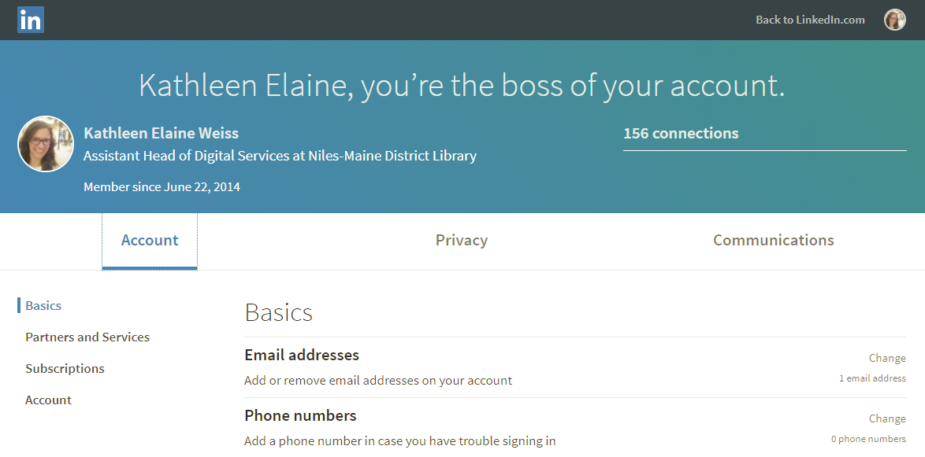
Me > Account & Settings
Notes:
Timeframe: 5 minutes
Explain that LinkedIn is a global network of business professionals with over 300 million users in over 200 countries.
Share that the purpose of LinkedIn is to allow people in like industries and companies to connect, share information and recruit talent for jobs and projects.
Discuss that Home page is the place where users are notified of what’s going on in their circles (like articles, notifications, suggested jobs, groups, and connections).
Share that Profile page is the area where folks build their online “resume,” and that it includes many category options, depending on how detailed folks want to be.
Explain that a Connection is someone to whom the user has linked his or herself and that as a result, they are able to see each other’s information, write recommendations, endorse each other and other activities (like a “Friend” on Facebook). Explain that there are 3 levels of connection- 1st (1:1 connection), 2nd (connection of a connection), and 3rd (connection of a connection of a connection). Share that this can be useful in building a professional network.
Highlight that an Introduction is a tool for getting connected with a 2nd or 3rd level connection.
Discuss that one of the most powerful tools in LinkedIn is the Recommendation feature, which allows users to write online recommendations for one another that are visible on their profiles. Share that recruiters use this ALL THE TIME as a way to screen job candidates.
Explain that the Jobs section allows users to search for open positions in their industries and in many cases, apply directly from LinkedIn.
Share that the Interests section allows users to get information on companies and organizations, follow them, and join groups.

Slide 22
The Home Page
Notes:
How presentation will benefit audience: Adult learners are more interested in a subject if they know how or why it is important to them.
Presenter’s level of expertise in the subject: Briefly state your credentials in this area, or explain why participants should listen to you.

Slide 23
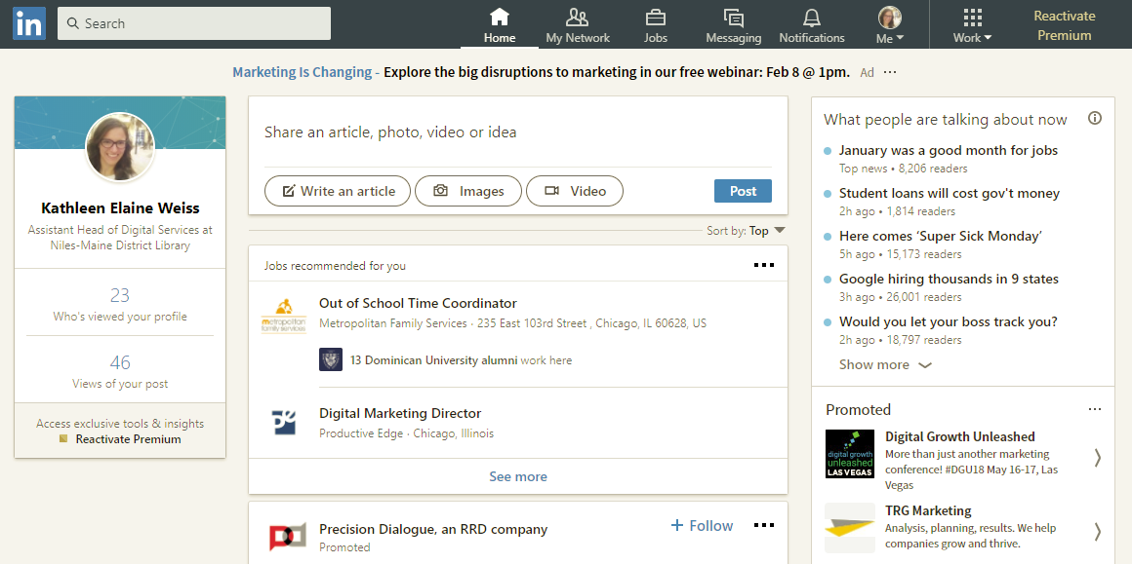
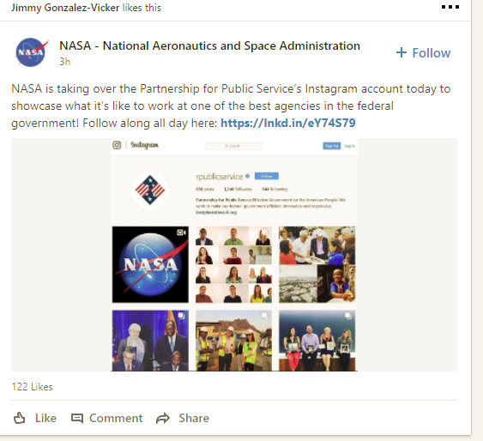
The Home Page
Notes:
Do a live demo of the Home page. Highlight and discuss the areas of the page listed above.

Slide 24
Me > View My Profile
Notes:
How presentation will benefit audience: Adult learners are more interested in a subject if they know how or why it is important to them.
Presenter’s level of expertise in the subject: Briefly state your credentials in this area, or explain why participants should listen to you.

Slide 25
Me > View My Profile
Notes:
Timeframe: 5 minutes
Explain that LinkedIn is a global network of business professionals with over 300 million users in over 200 countries.
Share that the purpose of LinkedIn is to allow people in like industries and companies to connect, share information and recruit talent for jobs and projects.
Discuss that Home page is the place where users are notified of what’s going on in their circles (like articles, notifications, suggested jobs, groups, and connections).
Share that Profile page is the area where folks build their online “resume,” and that it includes many category options, depending on how detailed folks want to be.
Explain that a Connection is someone to whom the user has linked his or herself and that as a result, they are able to see each other’s information, write recommendations, endorse each other and other activities (like a “Friend” on Facebook). Explain that there are 3 levels of connection- 1st (1:1 connection), 2nd (connection of a connection), and 3rd (connection of a connection of a connection). Share that this can be useful in building a professional network.
Highlight that an Introduction is a tool for getting connected with a 2nd or 3rd level connection.
Discuss that one of the most powerful tools in LinkedIn is the Recommendation feature, which allows users to write online recommendations for one another that are visible on their profiles. Share that recruiters use this ALL THE TIME as a way to screen job candidates.
Explain that the Jobs section allows users to search for open positions in their industries and in many cases, apply directly from LinkedIn.
Share that the Interests section allows users to get information on companies and organizations, follow them, and join groups.

Slide 26
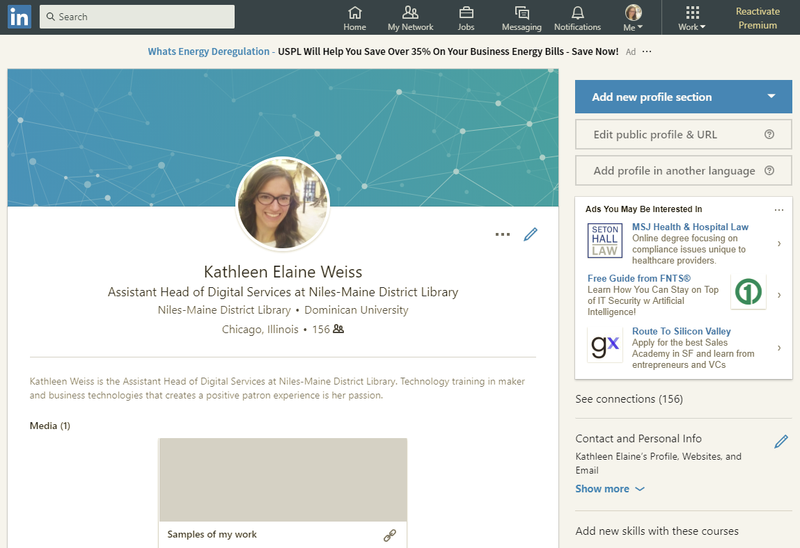
Intro & Edit Profile/URL
Notes:
Do a live demo of the Profile page. Highlight and discuss the areas of the page listed above.

Slide 27
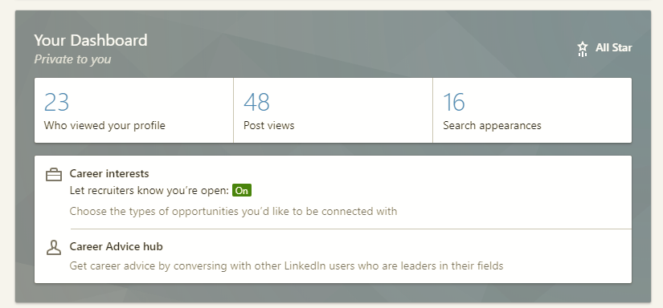
Your Dashboard
Notes:
Do a live demo of the Profile page. Highlight and discuss the areas of the page listed above.

Slide 28
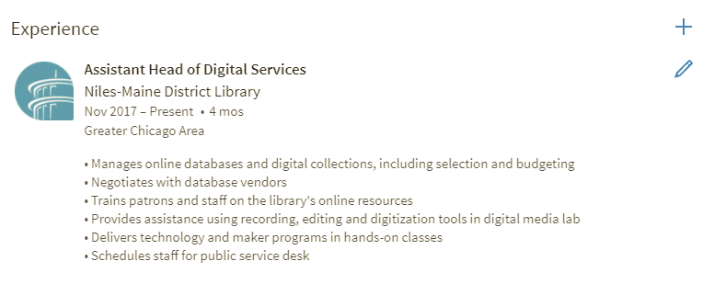
Background
Notes:
Do a live demo of the Profile page. Highlight and discuss the areas of the page listed above.

Slide 29
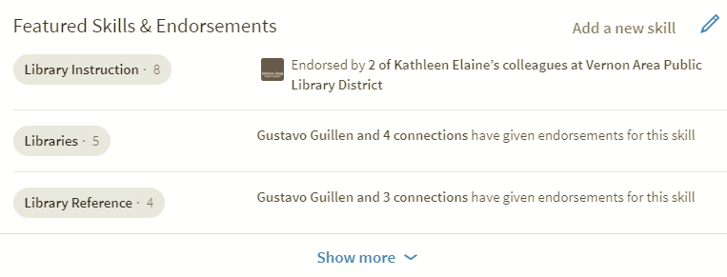
Featured Skills & Endorsements
Notes:
Do a live demo of the Profile page. Highlight and discuss the areas of the page listed above.

Slide 30
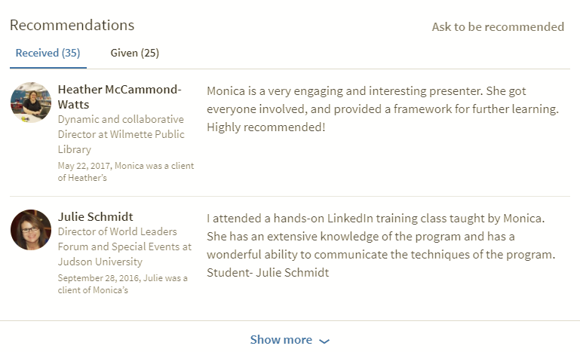
Recommendations
Notes:
Do a live demo of the Profile page. Highlight and discuss the areas of the page listed above.

Slide 31
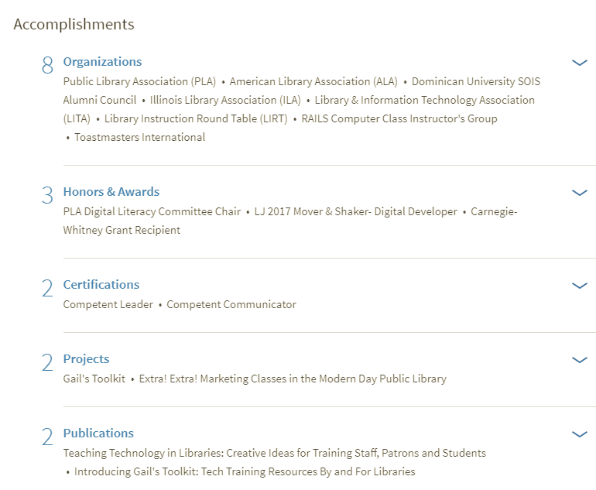
Accomplishments
Notes:
Do a live demo of the Profile page. Highlight and discuss the areas of the page listed above.

Slide 32
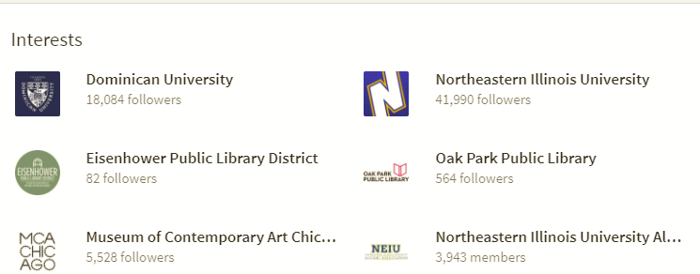
Interests
Notes:
Do a live demo of the Profile page. Highlight and discuss the areas of the page listed above.

Slide 33
My Network
Notes:
How presentation will benefit audience: Adult learners are more interested in a subject if they know how or why it is important to them.
Presenter’s level of expertise in the subject: Briefly state your credentials in this area, or explain why participants should listen to you.

Slide 34
My Network
Notes:
Timeframe: 5 minutes
Explain that LinkedIn is a global network of business professionals with over 300 million users in over 200 countries.
Share that the purpose of LinkedIn is to allow people in like industries and companies to connect, share information and recruit talent for jobs and projects.
Discuss that Home page is the place where users are notified of what’s going on in their circles (like articles, notifications, suggested jobs, groups, and connections).
Share that Profile page is the area where folks build their online “resume,” and that it includes many category options, depending on how detailed folks want to be.
Explain that a Connection is someone to whom the user has linked his or herself and that as a result, they are able to see each other’s information, write recommendations, endorse each other and other activities (like a “Friend” on Facebook). Explain that there are 3 levels of connection- 1st (1:1 connection), 2nd (connection of a connection), and 3rd (connection of a connection of a connection). Share that this can be useful in building a professional network.
Highlight that an Introduction is a tool for getting connected with a 2nd or 3rd level connection.
Discuss that one of the most powerful tools in LinkedIn is the Recommendation feature, which allows users to write online recommendations for one another that are visible on their profiles. Share that recruiters use this ALL THE TIME as a way to screen job candidates.
Explain that the Jobs section allows users to search for open positions in their industries and in many cases, apply directly from LinkedIn.
Share that the Interests section allows users to get information on companies and organizations, follow them, and join groups.

Slide 35
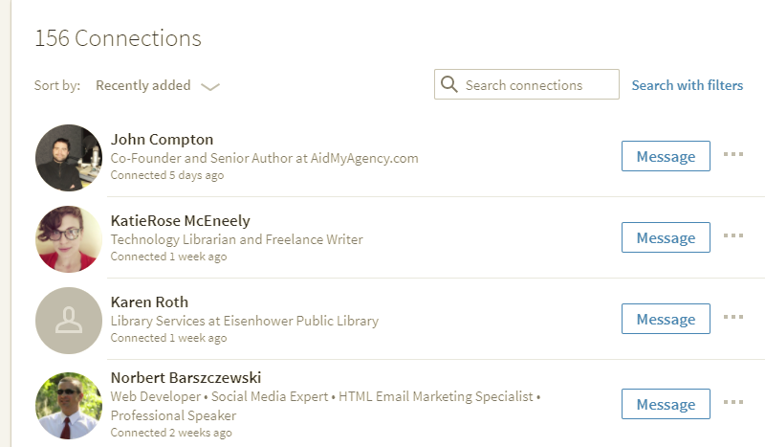
My Network >See all
Notes:
Do a live demo of the Interests: Companies page. Highlight and discuss the areas of the page listed above.

Slide 36
Jobs
Notes:
How presentation will benefit audience: Adult learners are more interested in a subject if they know how or why it is important to them.
Presenter’s level of expertise in the subject: Briefly state your credentials in this area, or explain why participants should listen to you.

Slide 37
Jobs
Notes:
Timeframe: 5 minutes
Explain that LinkedIn is a global network of business professionals with over 300 million users in over 200 countries.
Share that the purpose of LinkedIn is to allow people in like industries and companies to connect, share information and recruit talent for jobs and projects.
Discuss that Home page is the place where users are notified of what’s going on in their circles (like articles, notifications, suggested jobs, groups, and connections).
Share that Profile page is the area where folks build their online “resume,” and that it includes many category options, depending on how detailed folks want to be.
Explain that a Connection is someone to whom the user has linked his or herself and that as a result, they are able to see each other’s information, write recommendations, endorse each other and other activities (like a “Friend” on Facebook). Explain that there are 3 levels of connection- 1st (1:1 connection), 2nd (connection of a connection), and 3rd (connection of a connection of a connection). Share that this can be useful in building a professional network.
Highlight that an Introduction is a tool for getting connected with a 2nd or 3rd level connection.
Discuss that one of the most powerful tools in LinkedIn is the Recommendation feature, which allows users to write online recommendations for one another that are visible on their profiles. Share that recruiters use this ALL THE TIME as a way to screen job candidates.
Explain that the Jobs section allows users to search for open positions in their industries and in many cases, apply directly from LinkedIn.
Share that the Interests section allows users to get information on companies and organizations, follow them, and join groups.

Slide 38
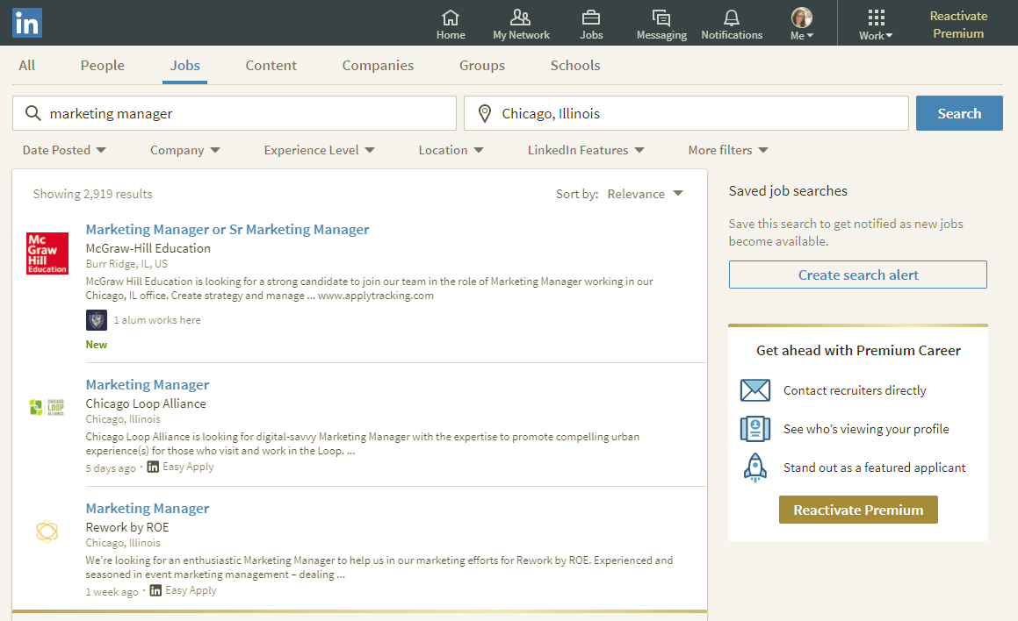
Jobs
Notes:
Timeframe: 5 minutes
Explain that LinkedIn is a global network of business professionals with over 300 million users in over 200 countries.
Share that the purpose of LinkedIn is to allow people in like industries and companies to connect, share information and recruit talent for jobs and projects.
Discuss that Home page is the place where users are notified of what’s going on in their circles (like articles, notifications, suggested jobs, groups, and connections).
Share that Profile page is the area where folks build their online “resume,” and that it includes many category options, depending on how detailed folks want to be.
Explain that a Connection is someone to whom the user has linked his or herself and that as a result, they are able to see each other’s information, write recommendations, endorse each other and other activities (like a “Friend” on Facebook). Explain that there are 3 levels of connection- 1st (1:1 connection), 2nd (connection of a connection), and 3rd (connection of a connection of a connection). Share that this can be useful in building a professional network.
Highlight that an Introduction is a tool for getting connected with a 2nd or 3rd level connection.
Discuss that one of the most powerful tools in LinkedIn is the Recommendation feature, which allows users to write online recommendations for one another that are visible on their profiles. Share that recruiters use this ALL THE TIME as a way to screen job candidates.
Explain that the Jobs section allows users to search for open positions in their industries and in many cases, apply directly from LinkedIn.
Share that the Interests section allows users to get information on companies and organizations, follow them, and join groups.

Slide 39
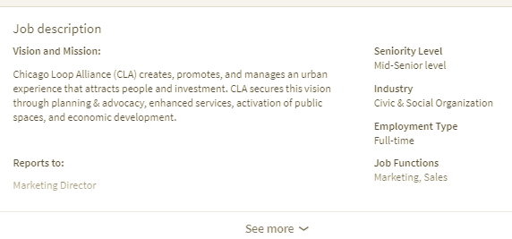
Jobs
Notes:
Timeframe: 5 minutes
Explain that LinkedIn is a global network of business professionals with over 300 million users in over 200 countries.
Share that the purpose of LinkedIn is to allow people in like industries and companies to connect, share information and recruit talent for jobs and projects.
Discuss that Home page is the place where users are notified of what’s going on in their circles (like articles, notifications, suggested jobs, groups, and connections).
Share that Profile page is the area where folks build their online “resume,” and that it includes many category options, depending on how detailed folks want to be.
Explain that a Connection is someone to whom the user has linked his or herself and that as a result, they are able to see each other’s information, write recommendations, endorse each other and other activities (like a “Friend” on Facebook). Explain that there are 3 levels of connection- 1st (1:1 connection), 2nd (connection of a connection), and 3rd (connection of a connection of a connection). Share that this can be useful in building a professional network.
Highlight that an Introduction is a tool for getting connected with a 2nd or 3rd level connection.
Discuss that one of the most powerful tools in LinkedIn is the Recommendation feature, which allows users to write online recommendations for one another that are visible on their profiles. Share that recruiters use this ALL THE TIME as a way to screen job candidates.
Explain that the Jobs section allows users to search for open positions in their industries and in many cases, apply directly from LinkedIn.
Share that the Interests section allows users to get information on companies and organizations, follow them, and join groups.

Slide 40
The Search Box
Notes:
How presentation will benefit audience: Adult learners are more interested in a subject if they know how or why it is important to them.
Presenter’s level of expertise in the subject: Briefly state your credentials in this area, or explain why participants should listen to you.

Slide 41
Search Box
Search for:
People
Jobs
Companies
Organizations
Schools
Notes:
Timeframe: 5 minutes
Explain that LinkedIn is a global network of business professionals with over 300 million users in over 200 countries.
Share that the purpose of LinkedIn is to allow people in like industries and companies to connect, share information and recruit talent for jobs and projects.
Discuss that Home page is the place where users are notified of what’s going on in their circles (like articles, notifications, suggested jobs, groups, and connections).
Share that Profile page is the area where folks build their online “resume,” and that it includes many category options, depending on how detailed folks want to be.
Explain that a Connection is someone to whom the user has linked his or herself and that as a result, they are able to see each other’s information, write recommendations, endorse each other and other activities (like a “Friend” on Facebook). Explain that there are 3 levels of connection- 1st (1:1 connection), 2nd (connection of a connection), and 3rd (connection of a connection of a connection). Share that this can be useful in building a professional network.
Highlight that an Introduction is a tool for getting connected with a 2nd or 3rd level connection.
Discuss that one of the most powerful tools in LinkedIn is the Recommendation feature, which allows users to write online recommendations for one another that are visible on their profiles. Share that recruiters use this ALL THE TIME as a way to screen job candidates.
Explain that the Jobs section allows users to search for open positions in their industries and in many cases, apply directly from LinkedIn.
Share that the Interests section allows users to get information on companies and organizations, follow them, and join groups.

Slide 42
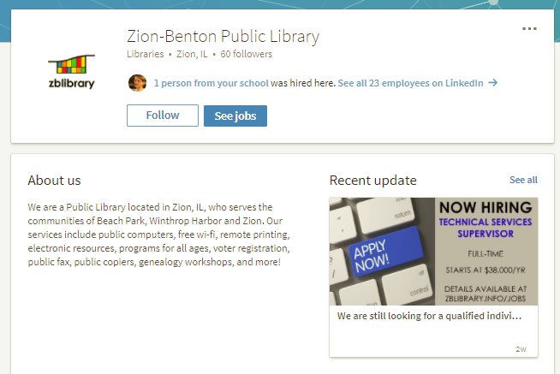
Follow
Notes:
Timeframe: 5 minutes
Explain that LinkedIn is a global network of business professionals with over 300 million users in over 200 countries.
Share that the purpose of LinkedIn is to allow people in like industries and companies to connect, share information and recruit talent for jobs and projects.
Discuss that Home page is the place where users are notified of what’s going on in their circles (like articles, notifications, suggested jobs, groups, and connections).
Share that Profile page is the area where folks build their online “resume,” and that it includes many category options, depending on how detailed folks want to be.
Explain that a Connection is someone to whom the user has linked his or herself and that as a result, they are able to see each other’s information, write recommendations, endorse each other and other activities (like a “Friend” on Facebook). Explain that there are 3 levels of connection- 1st (1:1 connection), 2nd (connection of a connection), and 3rd (connection of a connection of a connection). Share that this can be useful in building a professional network.
Highlight that an Introduction is a tool for getting connected with a 2nd or 3rd level connection.
Discuss that one of the most powerful tools in LinkedIn is the Recommendation feature, which allows users to write online recommendations for one another that are visible on their profiles. Share that recruiters use this ALL THE TIME as a way to screen job candidates.
Explain that the Jobs section allows users to search for open positions in their industries and in many cases, apply directly from LinkedIn.
Share that the Interests section allows users to get information on companies and organizations, follow them, and join groups.

Slide 43
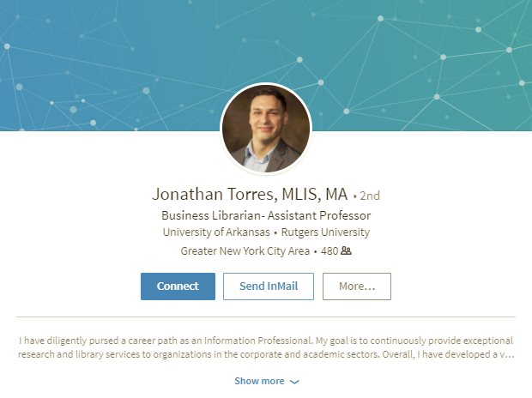
Connect
Notes:
Timeframe: 5 minutes
Explain that LinkedIn is a global network of business professionals with over 300 million users in over 200 countries.
Share that the purpose of LinkedIn is to allow people in like industries and companies to connect, share information and recruit talent for jobs and projects.
Discuss that Home page is the place where users are notified of what’s going on in their circles (like articles, notifications, suggested jobs, groups, and connections).
Share that Profile page is the area where folks build their online “resume,” and that it includes many category options, depending on how detailed folks want to be.
Explain that a Connection is someone to whom the user has linked his or herself and that as a result, they are able to see each other’s information, write recommendations, endorse each other and other activities (like a “Friend” on Facebook). Explain that there are 3 levels of connection- 1st (1:1 connection), 2nd (connection of a connection), and 3rd (connection of a connection of a connection). Share that this can be useful in building a professional network.
Highlight that an Introduction is a tool for getting connected with a 2nd or 3rd level connection.
Discuss that one of the most powerful tools in LinkedIn is the Recommendation feature, which allows users to write online recommendations for one another that are visible on their profiles. Share that recruiters use this ALL THE TIME as a way to screen job candidates.
Explain that the Jobs section allows users to search for open positions in their industries and in many cases, apply directly from LinkedIn.
Share that the Interests section allows users to get information on companies and organizations, follow them, and join groups.

Slide 44
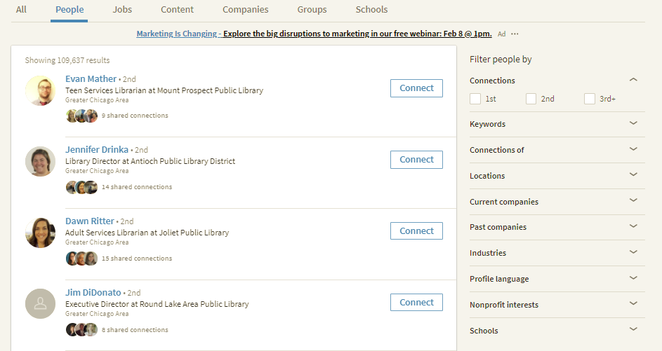
Advanced Search

Slide 45
Creating an Account
Notes:
How presentation will benefit audience: Adult learners are more interested in a subject if they know how or why it is important to them.
Presenter’s level of expertise in the subject: Briefly state your credentials in this area, or explain why participants should listen to you.

Slide 46
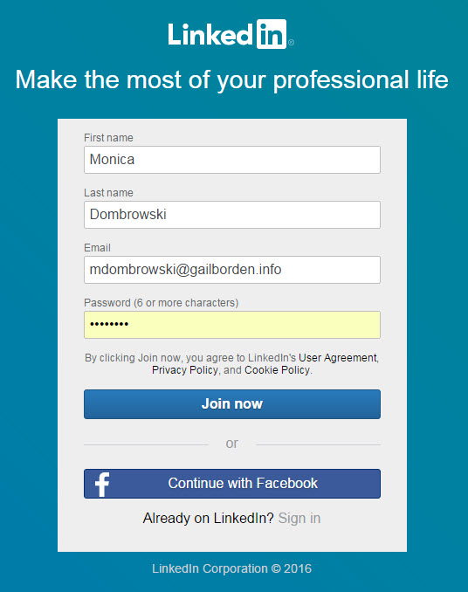
Creating an Account
Notes:
How presentation will benefit audience: Adult learners are more interested in a subject if they know how or why it is important to them.
Presenter’s level of expertise in the subject: Briefly state your credentials in this area, or explain why participants should listen to you.

Slide 47
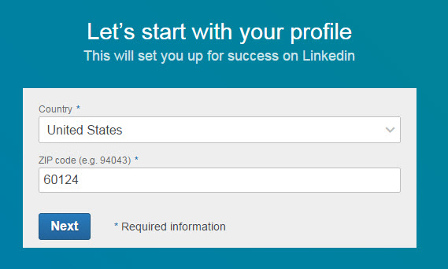
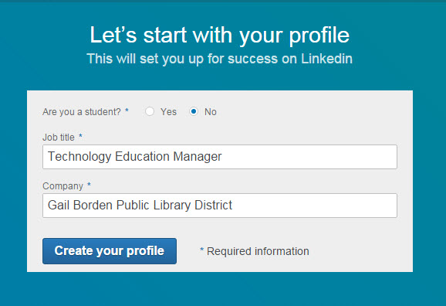
Creating an Account
Notes:
How presentation will benefit audience: Adult learners are more interested in a subject if they know how or why it is important to them.
Presenter’s level of expertise in the subject: Briefly state your credentials in this area, or explain why participants should listen to you.

Slide 48
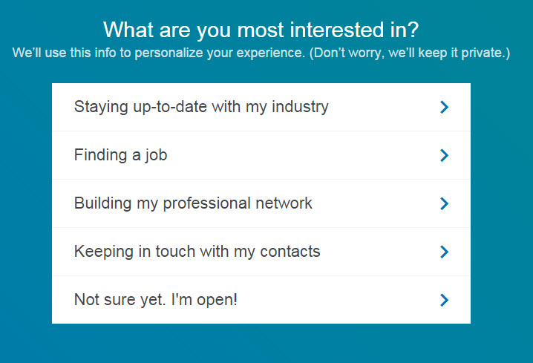
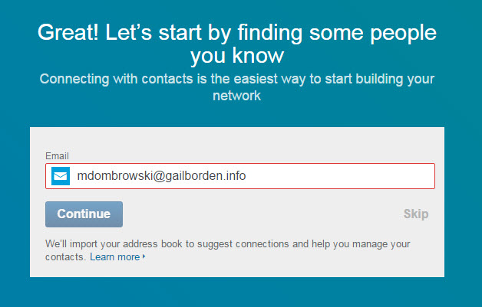
Creating an Account
Notes:
How presentation will benefit audience: Adult learners are more interested in a subject if they know how or why it is important to them.
Presenter’s level of expertise in the subject: Briefly state your credentials in this area, or explain why participants should listen to you.

Slide 49
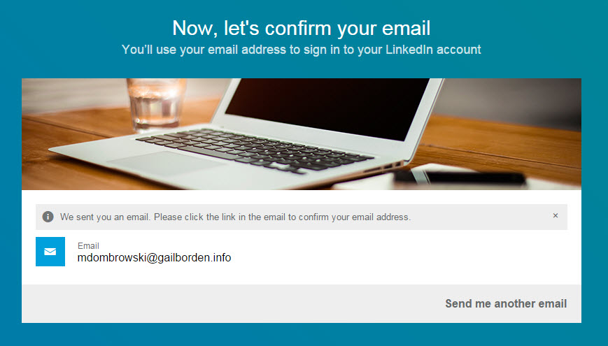
Creating an Account
Notes:
How presentation will benefit audience: Adult learners are more interested in a subject if they know how or why it is important to them.
Presenter’s level of expertise in the subject: Briefly state your credentials in this area, or explain why participants should listen to you.

Slide 50
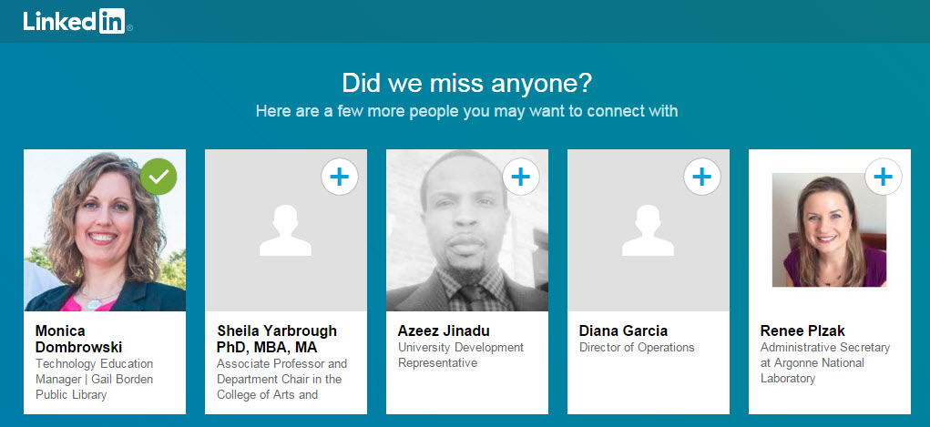
Creating an Account
Notes:
How presentation will benefit audience: Adult learners are more interested in a subject if they know how or why it is important to them.
Presenter’s level of expertise in the subject: Briefly state your credentials in this area, or explain why participants should listen to you.

Slide 51
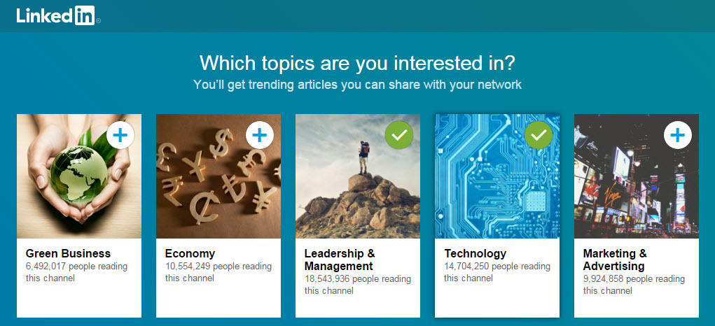
Creating an Account
Notes:
How presentation will benefit audience: Adult learners are more interested in a subject if they know how or why it is important to them.
Presenter’s level of expertise in the subject: Briefly state your credentials in this area, or explain why participants should listen to you.

Slide 52
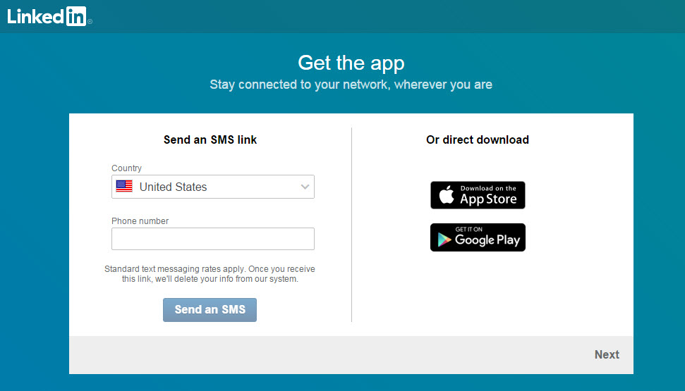
Creating an Account
Notes:
How presentation will benefit audience: Adult learners are more interested in a subject if they know how or why it is important to them.
Presenter’s level of expertise in the subject: Briefly state your credentials in this area, or explain why participants should listen to you.

Slide 53
Creating an Account
Notes:
How presentation will benefit audience: Adult learners are more interested in a subject if they know how or why it is important to them.
Presenter’s level of expertise in the subject: Briefly state your credentials in this area, or explain why participants should listen to you.

