Slide 1
What is The Cloud?
An Introduction to Cloud Computing

Slide 2
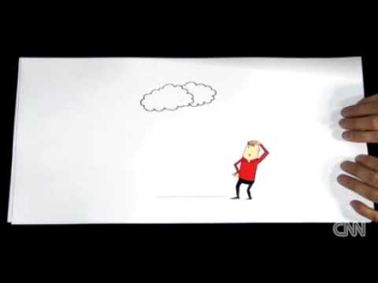

Slide 3
Defining The Cloud
The Cloud: A broad term used when talking about "The Internet" but with an emphasis on web applications and online storage.
Cloud Computing: Internet-based computing in which large groups of remote servers are networked so as to allow sharing of data-processing tasks, centralized data storage, and online access to computer services or resources. - www.dictionary.com

Slide 4
How does it work?
Data Centers: The facilities that house cloud storage systems.
Where stuff you upload into "the cloud" lives.
"A client (e.g., a computer user subscribing to a cloud storage service) sends copies of files over the Internet to the data server, which then records the information. When the client wishes to retrieve the information, he or she accesses the data server through a Web-based interface. The server then either sends the files back to the client or allows the client to access and manipulate the files on the server itself." - www.howstuffworks.com
What would be some benefits to cloud computing?
Can you think of any cloud services you might already use?

Slide 5
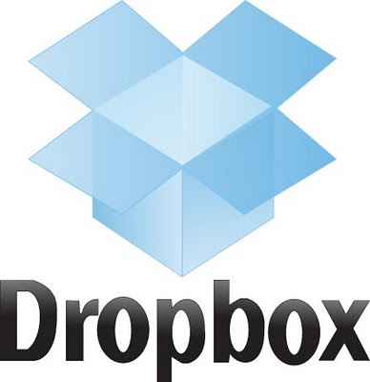
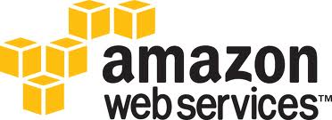
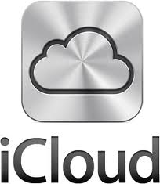
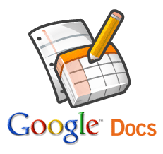
Examples of Cloud Services

Slide 6
Issues and Concerns
1. Reliability
2. Security & Privacy
Encryption
Authentication- usernames & passwords
Authorization
Philosophical Question- Who owns the data you upload into the cloud?

