Slide 1
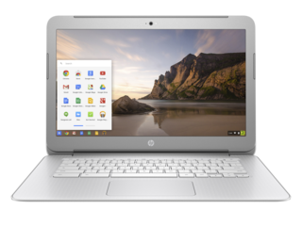
Meet the chromebook
Crystal Lake Public Library
Gadget Group Training
August 2016

Slide 2
Why are we here?

Slide 3
Agenda
Learn what a Chromebook is (10 minutes)
Talk about Google accounts (5 minutes)
Talk about Google apps (5 minutes)
Chromebook demonstrations (30 minutes)
Questions and evaluations (5 minutes)

Slide 4
What is a Chromebook?
Notebook computer
Runs Chrome OS as its operating system
Designed to be used primarily while connected to the Internet
Apps and data are in the cloud
Around since 2011

Slide 5
How is it different?
Nothing to set-up or configure
Log in with a Google account
Runs on Chrome OS
Updates automatically
No software to buy
Storage in cloud, not on device and needs WiFi to work
Keyboard has some different keys
Inexpensive, faster boot up, and have a longer battery life

Slide 6
Google Account

Slide 7
Google Apps

Slide 8
Google Apps for Common Tasks

Slide 9
Keyboard

Slide 10
Demonstration

Slide 11
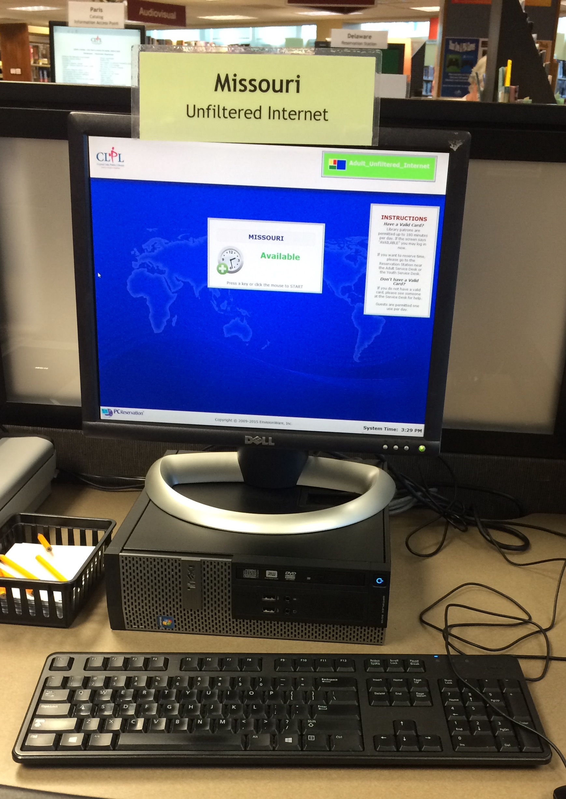
Print from Chromebook at CLPL
Use CLPL’s web printing service
Save file as PDF. Upload to web printing service.
Use CLPL’s print direct service
Save file as PDF. Forward PDF to print direct email address.
Use CLPL’s public computers and printers
Log in to Google account and print.

Slide 12
Let’s see what we learned.

Slide 13
What makes a Chromebook different from a regular laptop?
A. Runs on the Chrome operating system
B. Everything is stored in the cloud
C. Generally needs a wireless internet connection
D. All of the above.

Slide 14
What is one thing you can do in the Status Area?
A. Open Docs
B. Find apps
C. Connect to wireless network
D. Print

Slide 15
How do you get a map of the keyboard?
A. Press Alt + Search
B. Press Ctrl + Alt + ?
C. Visit AAA
D. Ask Siri

Slide 16
Which of the following is a Google App?
A. Pokémon Go
B. Docs
C. OverDrive
D. Safari
E. Slides
F. Both B & E

Slide 17
A patron asks you how to print. What do you tell them?
A. We don’t offer public printing.
B. You can use our web printing service. Here, let me show you.
C. I hate questions like this!
D. Let me get someone else to help you.

Slide 18
For more training

Slide 19
Practice and ask the experts.

Slide 20
Questions?

Slide 21
Thank you!
Ashlee
Cheryl
Hallie
Jodie
Kimberly D.
Kim I.
Penny
Terri

