Slide 1
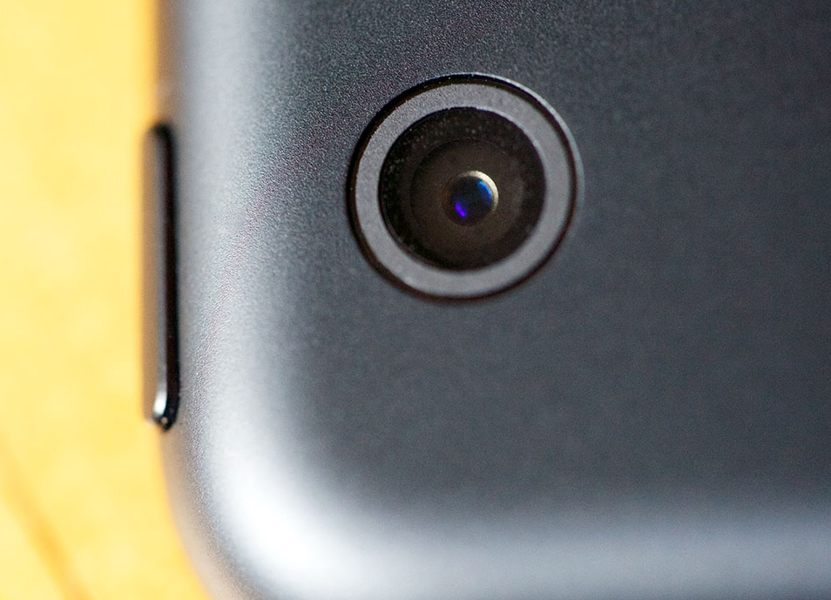
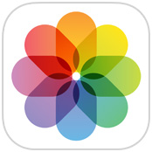
Welcome to
Make the Most of Your iPad’s Camera

Slide 2
Hi! I’m Ashlee.

Slide 3
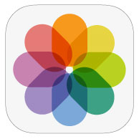
What We’ll Do Today
Take photos with Camera app
Edit photos with Photos app
Organize photos with Photos app
Share photos with Photos app

Slide 4
Be a good neighbor.

Slide 5
Taking Photos with iPad
PROS | CONS
One device Portable | Hard to keep steady

Slide 6
Differences in iPad cameras
Not sure of your iPad model?
You can identify your iPad model at https://support.apple.com/en-us/HT201471

Slide 10
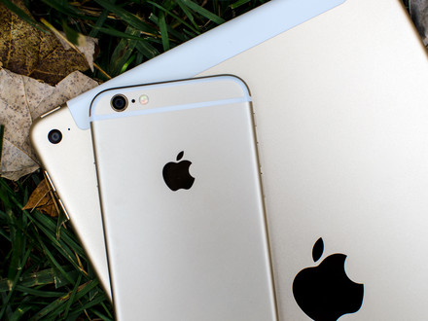
iPhone Camera | iPad Cameras
Flash | No flash
Optical zoom | No optical zoom
Better quality

Slide 11
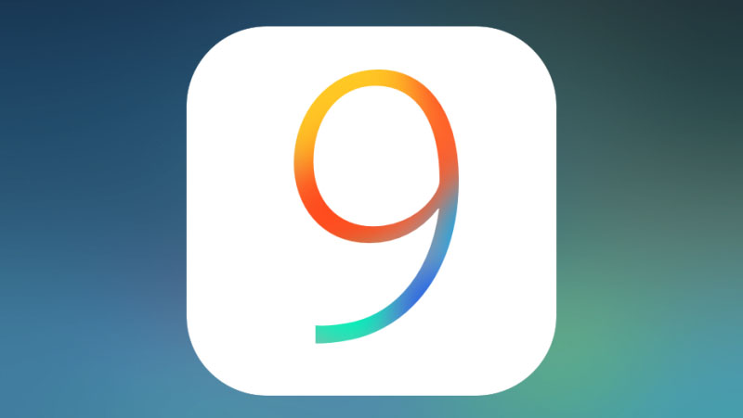
iOS Version

Slide 13
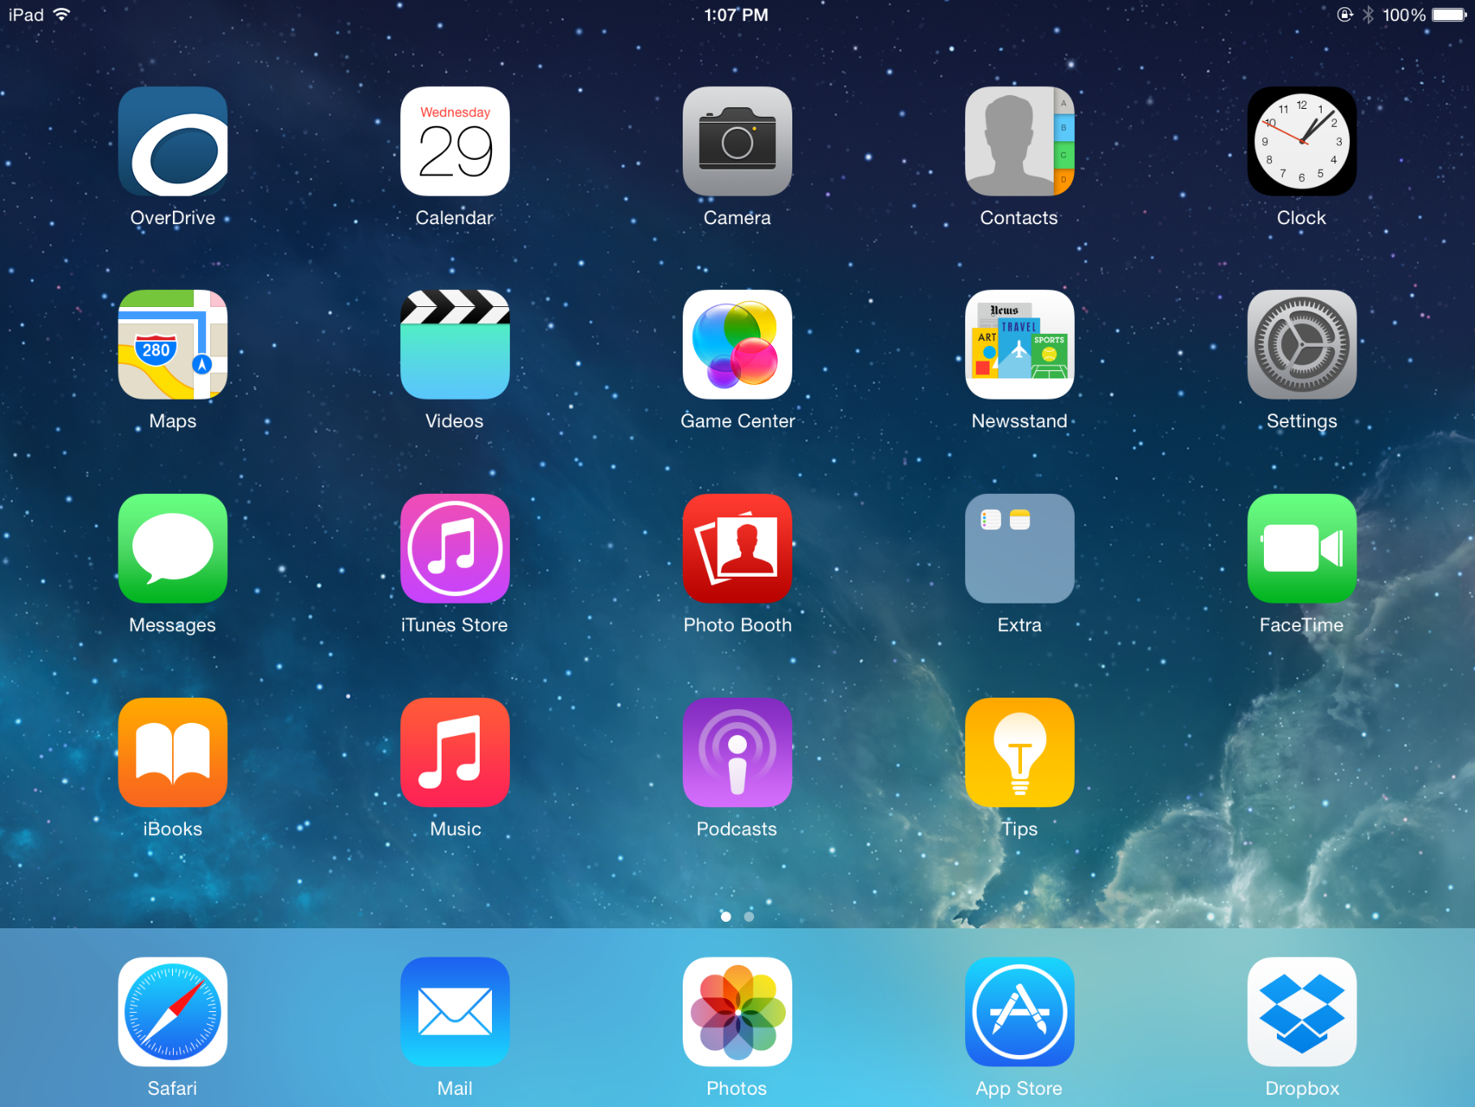
Touch the Camera app to open

Slide 14
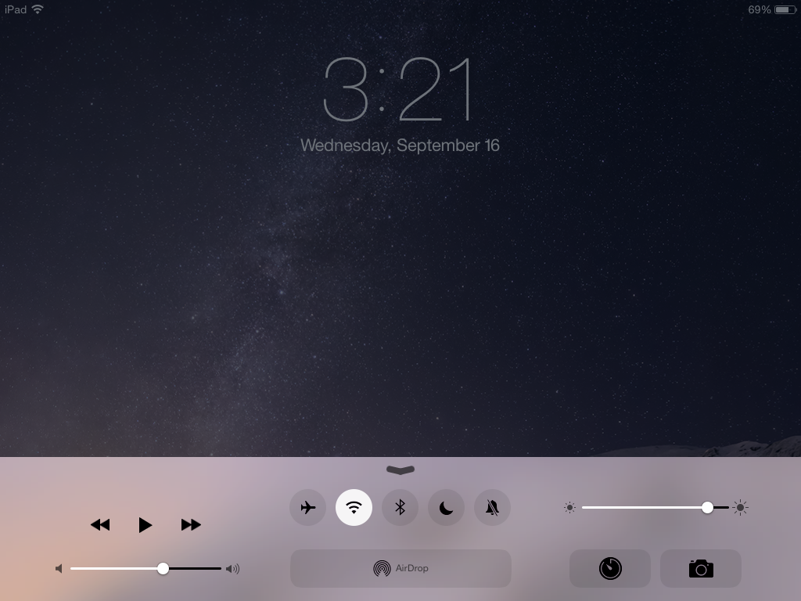
Swipe up from Lock Screen

Slide 15
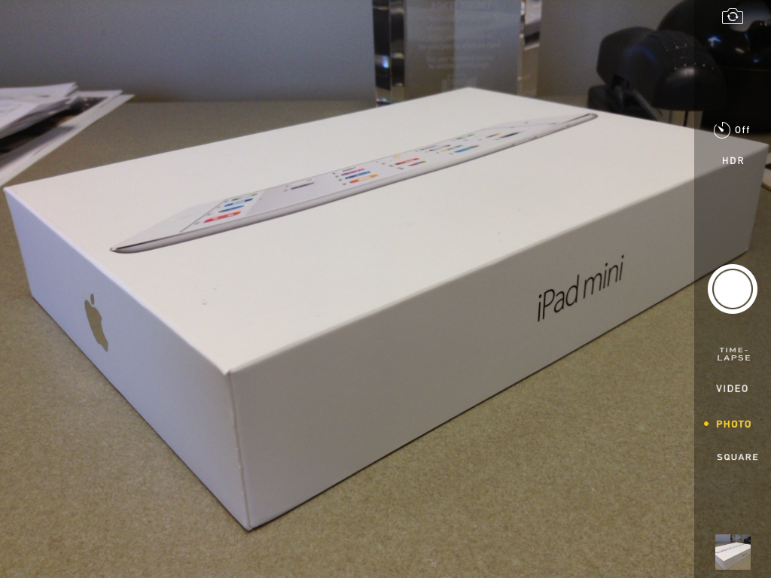
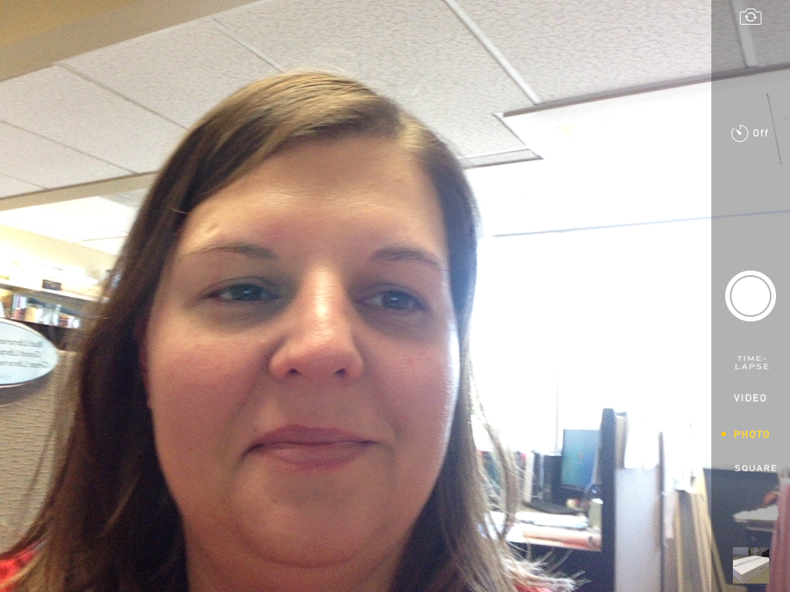
Back Camera & Front Camera

Slide 16
Options in Camera App
Time-Lapse
Timer
HDR
Video
Photo
Square
Take Picture Button
View Photos

Slide 19
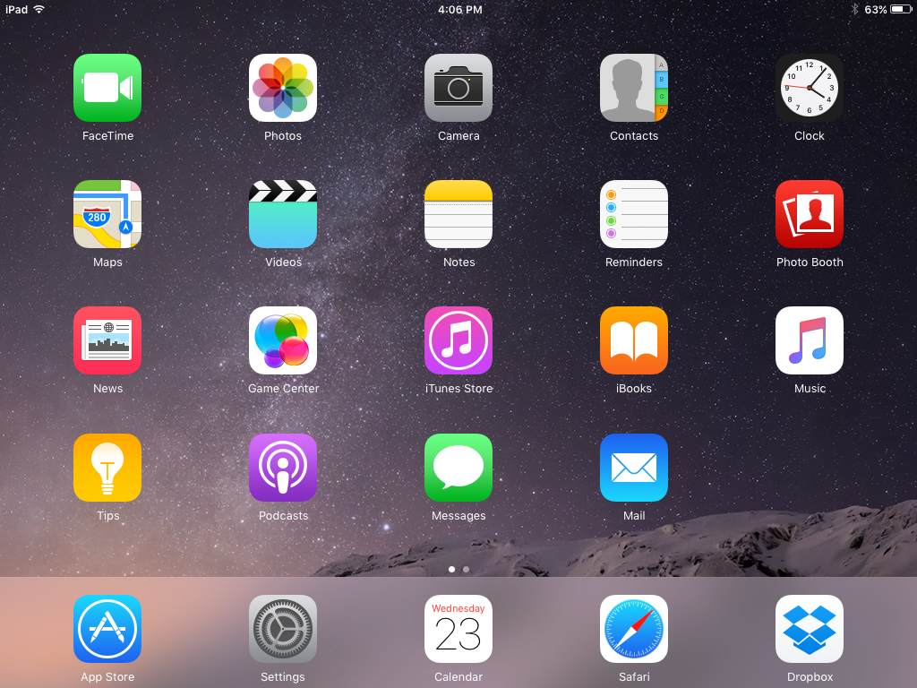
Touch the Photos app to open

Slide 20
Auto-Enhance
Crop/Straighten
Filters
Adjustments
Cancel

Slide 26
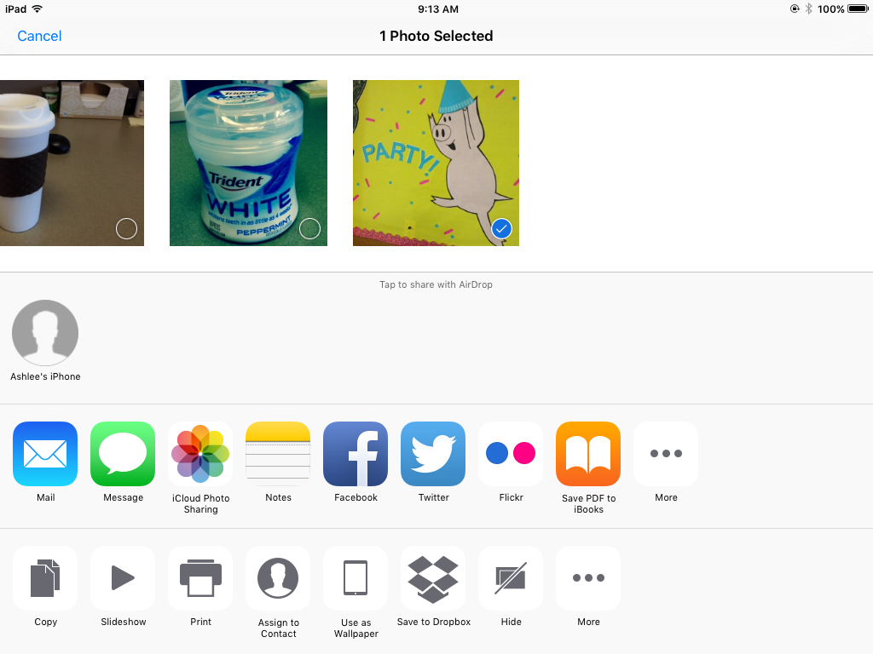

Slide 28
Understanding file sizes
1 Kilobyte KB | 1024 bytes
1 Megabyte MB | 1024 KB
1 Gigabyte GB | 1024 MB
1 Terabyte TB | 1024 GB
1 Petabyte PB | 1024 TB
Typical File Sizes
App | Normal JPG
Camera (take photo) | 1.66 MB
Photos (edit photo) | 1.49 MB

Slide 29
Touch the Settings app to open

Slide 30
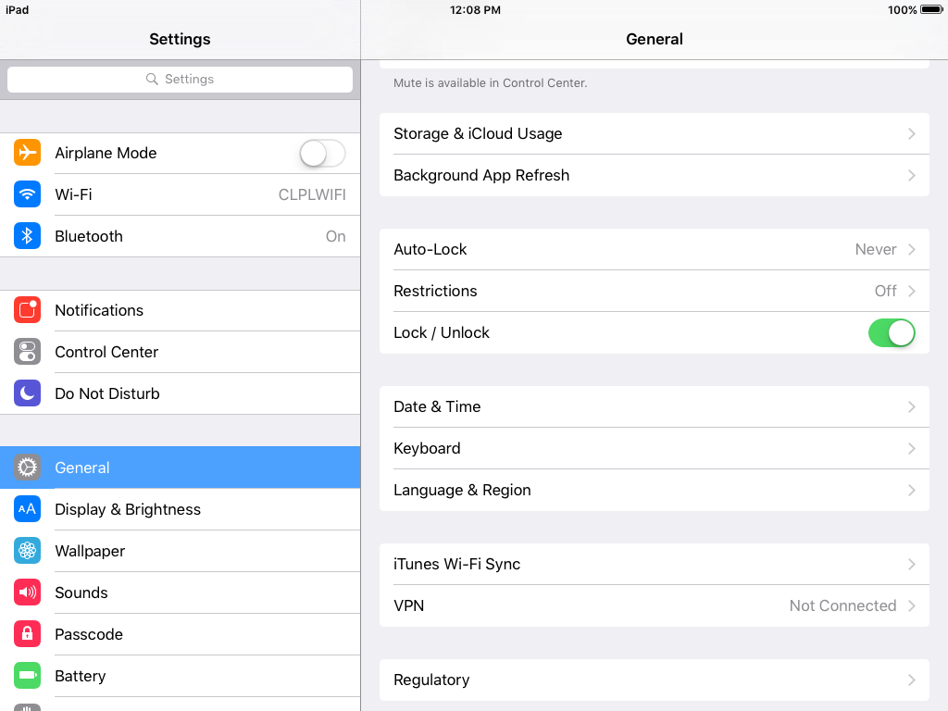
Touch General

Slide 31
Touch Storage & iCloud Usage

Slide 32
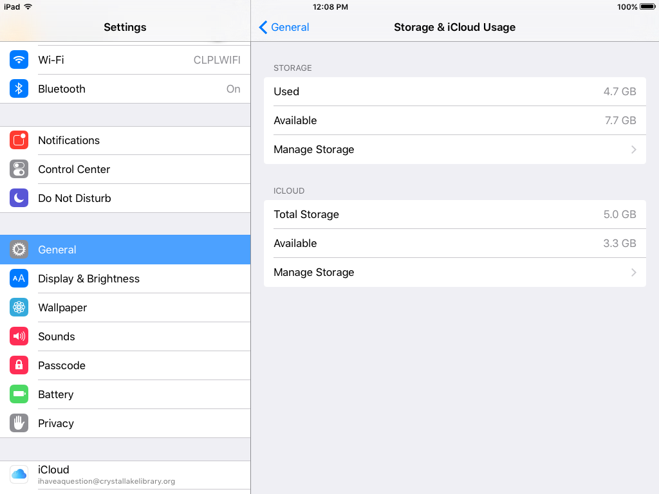
Touch Manage Storage
(under STORAGE)

Slide 33
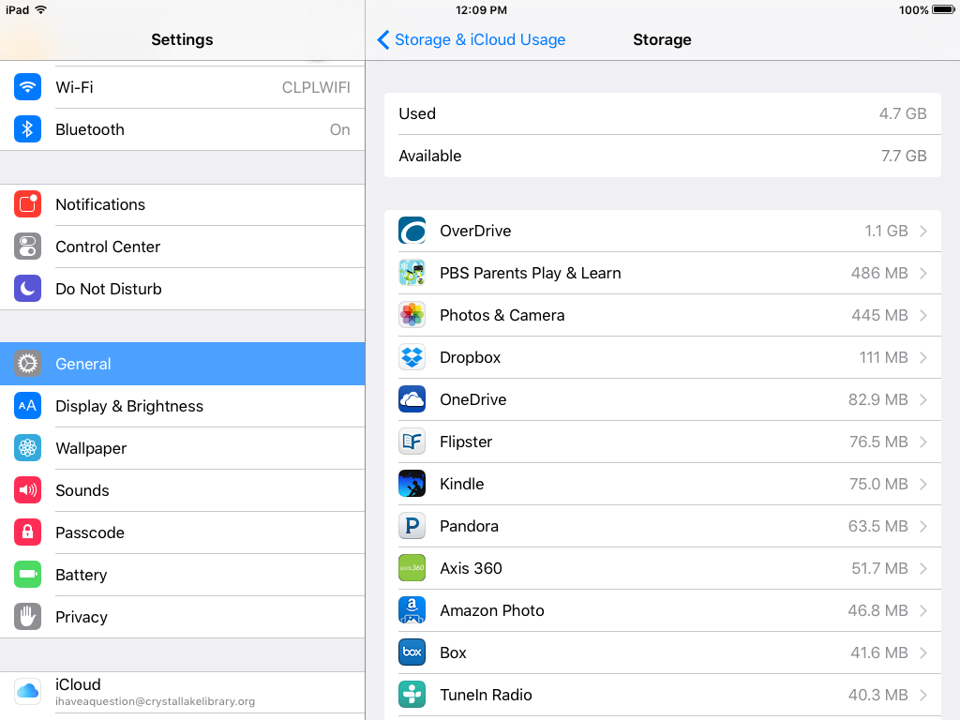
Touch Photos & Camera

Slide 34
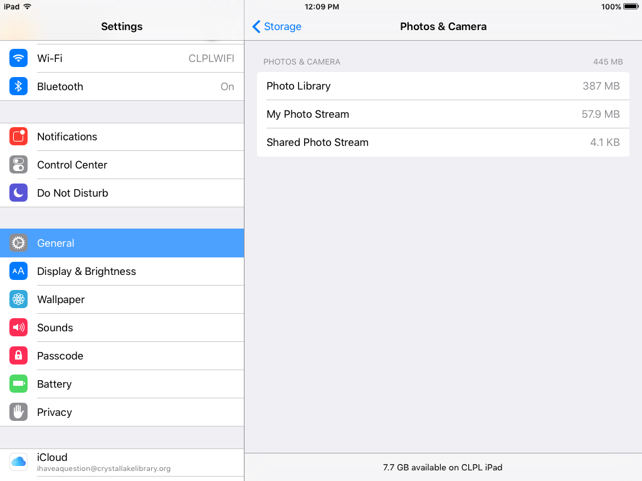
View storage

Slide 35
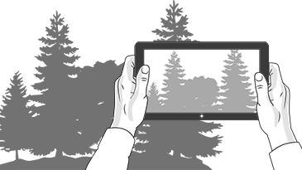
Thank you!
More Questions?
Sign up for a one-on-one appointment.
iCloud: Photos class on April 22, 2-4 PM
Online learning with Lynda.com (iCloud Essentials, iPhone and iPad Photography with iOS 9 )

