Slide 1


It’s in the Clouds? An Overview of Cloud Services
Michelle Vonderhaar
Thursday, July 10, 2014

Slide 2
What Is Cloud Computing?
In cloud computing, the word "cloud" (also phrased as "the cloud") is used as a metaphor for "the Internet," so the phrase cloud computing is used to mean a type of Internet-based computing, where different services -- such as servers, storage and applications -- are delivered to an organization's computers and devices through the Internet.
Webopedia.com

Slide 3
The Email Example
When using email -- Gmail, Hotmail, Yahoo Mail – your email messages are NOT on your computer, you can access them from anywhere, on any computer that is connected to the Internet.
      You do not download messages to your computer.

Slide 4
What does this mean for us?
Creating content (files)online
Storing files online so they can be accessed from any of your devices anywhere
Storing “content” (pictures, music, books)
Sharing content with others easily
Using content from any device anywhere

Slide 5
What you need to know?
3G/4G – The wireless signal your phone uses to connect to the internet. 4G is currently the fastest signal.
Online vs. Offline
  Online - your device is connected to the internet.
  Offline – your device is not currently connected to the Internet.
Sharing – giving others access to your data
Sync – the process that allows you to access the same data over MANY devices.
Wi-Fi (wireless fidelity) Wireless networking technology that uses radio waves to provide high-speed Internet and network connections.
Notes:
YouTube analogy... You can upload any of your videos to YouTube and choose who you want to see them. Everyone IN THE WORLD, only friends and family, only you.

Slide 6
What are the possible problems?
Having universal access from anywhere you can connect to the Web only works if you can connect to the Web.
  No Internet connection, no data
Perhaps the biggest concerns about cloud computing are security and privacy
  Do you trust the companies to ensure the safety of your data?
  Will your data become public?
Public vs Private
    Public – The ENTIRE world can see your data .
    Private- only you or designated individuals can see your data.

Slide 7
No your data isn’t secure in the cloud
Computer World.com
August 13, 2013
For example, Apple, AT&T and Yahoo each received only one gold star out of six. Dropbox, LinkedIn and Google all have five stars. Twitter and ISP Sonic.net were awarded six out of six gold stars for their efforts to protect user data.
http://www.computerworld.com/s/article/9241553/No_your_data_isn_t_secure_in_the_cloud?taxonomyId=223&pageNumber=1

Slide 8
Productivity Services (like Word, Excel and PowerPoint)
OneDrive
Google Drive
Evernote
Email – Google, Yahoo, Outlook.com
  Calendars
  Task Lists

Slide 9
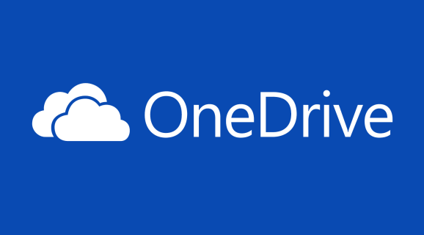
Let’s see what OneDrive can do?

Slide 10
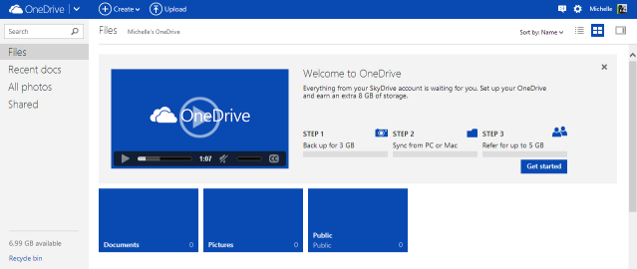
Microsoft OneDrive

Slide 11
File Sharing Services
Dropbox
Rapidshare
MegaShare
Mediafire
Dropio

Slide 12

What does Dropbox do?

Slide 13
File Storage and Back-up
Amazon Cloud Drive
Google Drive Storage
Microsoft OneDrive Storage
iCloud
Carbonite

Slide 14
Amazon Cloud Drive

Slide 15

iCloud
All of your purchased content (books, movies, music, and apps are automatically shared to all of your devices
Photo sharing with My Photo Stream
Back up of your personal data (including apps and music)
Up to date email, calendar and contacts
Find my iPhone
Open Safari tabs across all devices

Slide 16
Set up iCloud
Make sure you have the LATEST version of iOS
Turn on iCloud
  Settings – iCloud
  Enter Apple ID and password
Enable automatic download
  Music, Apps, Books
  Settings – iTunes and App Stores
Turn on iCloud for the rest of your devices

Slide 17
How much space do you get?
Amazon Cloud Drive – 5GB free space, $10/year for 20GB (more options available)
Google Drive – 15GB free space, 100GB $1.99/month (more options available)
iCloud – 5GB free space, $20/year for 10GB additional (more options available)
  iCloud Drive will be available with the iOS8 update. You will then have online viewing access to all of your files like Amazon or Google Drive

Slide 18



Fun Stuff
Photos
  Flickr
  Shutterfly
  Snapfish
Photoshop express -- photoshop.com
  http://www.photoshop.com/tools/overview
YouTube
Google Play
Amazon App Store
iTunes and App Store

Slide 19
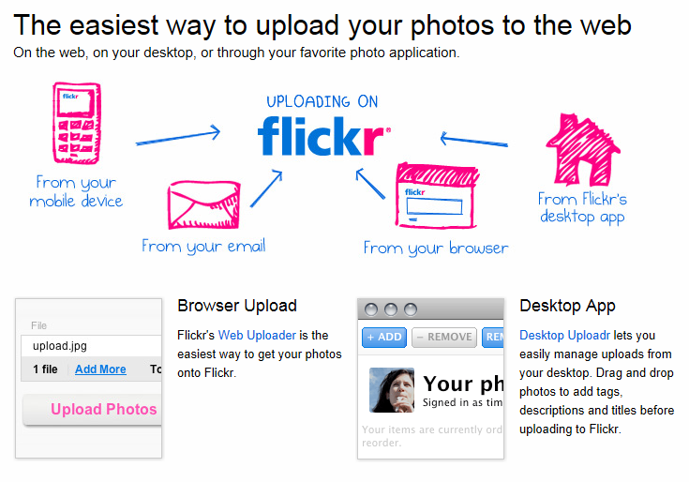
Organize your pictures?

Slide 20
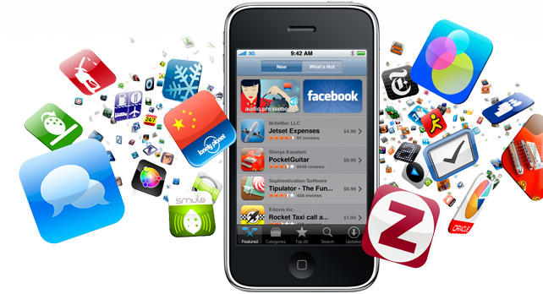
Apps
Evernote
Drive App
SkyDrive App
Flickr app
Dropbox App
Kindle App
NOOK App
OverDrive App

Slide 21
The Cloud in Action: Your cell phone contacts/pictures
What do you do when you buy a new cell phone? How do you transfer all that information?
  Have you ever backed up your contacts on your cell phone?
  Transferred them from phone to phone without a SIM card?

Slide 22
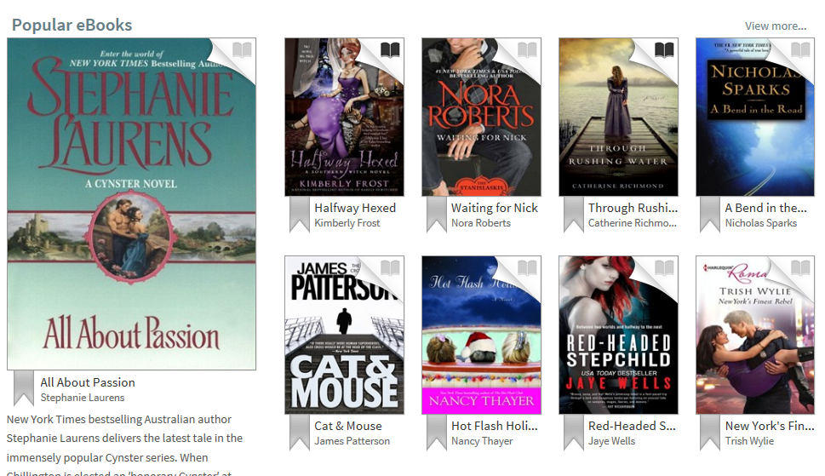
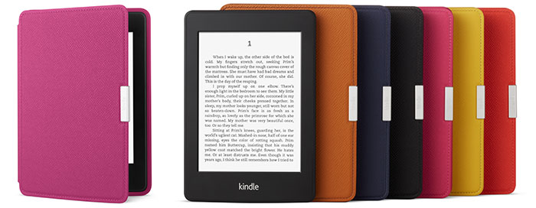
The Cloud in Action: Reading!
Kindle
NOOK
OverDrive

Slide 23
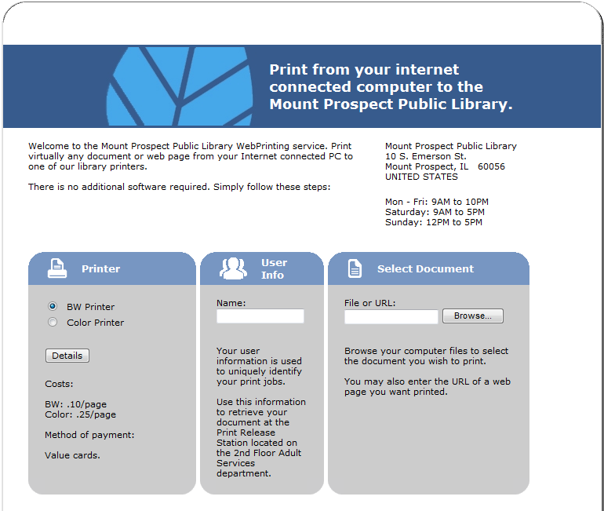
The Cloud in Action: Wireless Printing @ MPPL

Slide 24
Questions?

