Slide 1
How to Stream Movies and More!
Michelle Vonderhaar
Technology Training Coordinator
9/14/2015

Slide 2
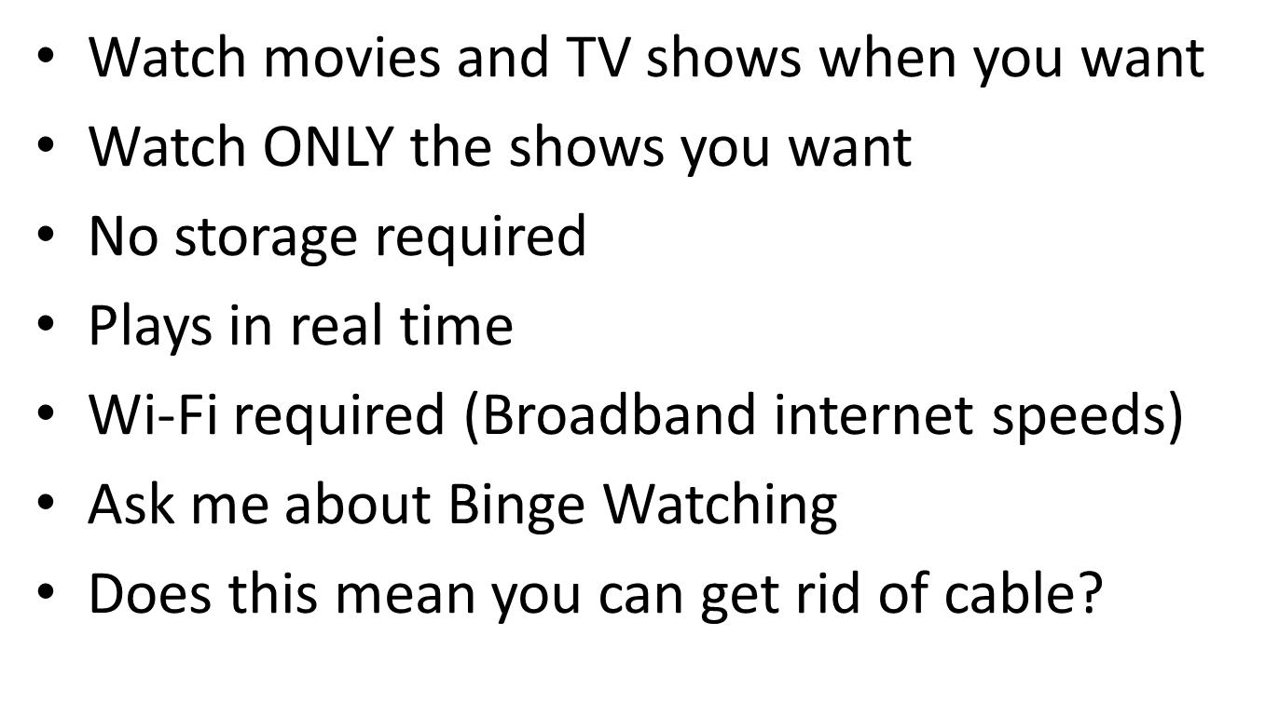
What is Streaming?

Slide 3
What Do You Need to Stream?
Streaming Device
Streaming Service
GOOD internet access/Wi-Fi
Time to watch ☺

Slide 4
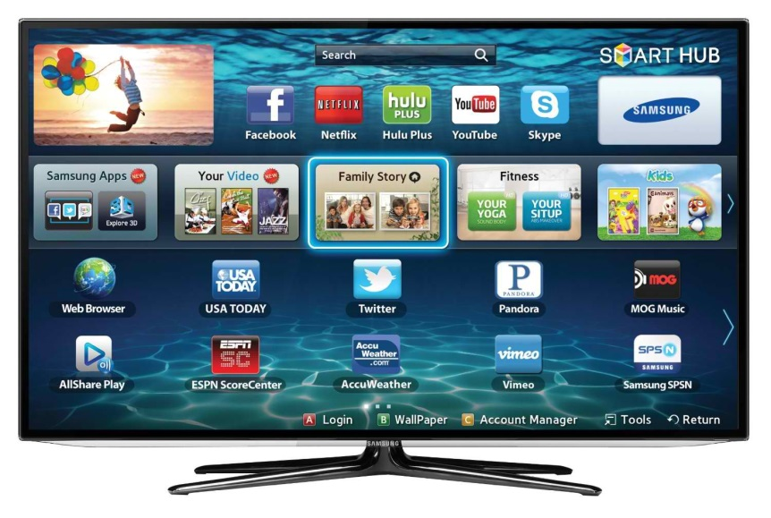
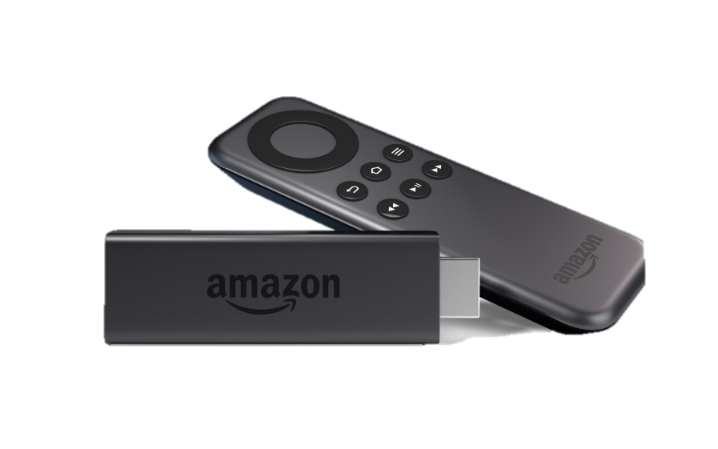
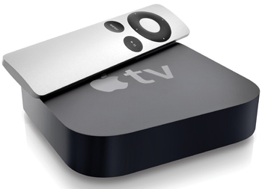
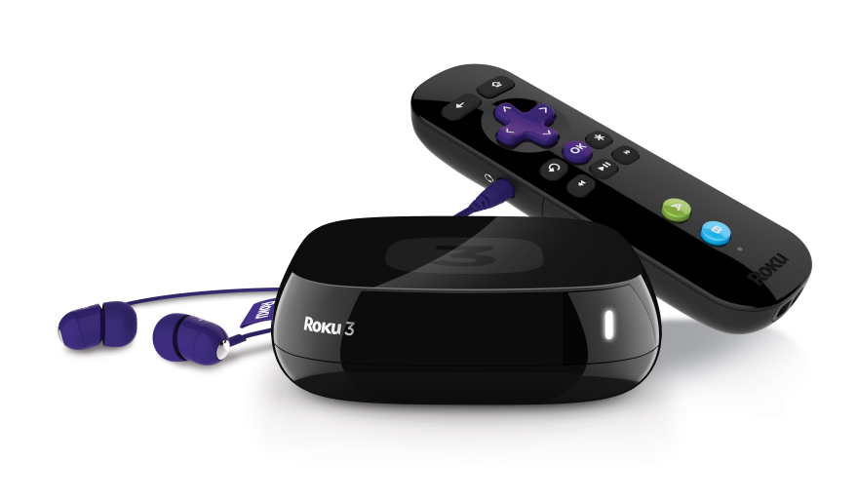
Media Streaming Devices

Slide 5
Amazon Fire tv can:
Stream Amazon Prime (Prime subscribers stream these titles for FREE!) and Amazon Instant Video
Stream Netflix, HuluPlus, HBO Go, ShowTime, Crackle and YouTube
Stream Pandora and iHeart Radio
Play games
FireStick$39

Slide 6
Apple TV can:
Stream iTunes movies, TV and music
Stream HBO Now
Current Version $69
New with Siri Search (October $149)

Slide 7
Google Chromecast can:
Stream Google Movies & TV, Netflix, HuluPlus, YouTube, WatchESPN and more
Stream Pandora, iHeart Radio and Google Music
Play games
Wirelessly mirror screens from Chromebook and other Android devices
$35

Slide 8
Roku Can:
Stream “thousands of Channels” including Netflix, HuluPlus, Amazon Instant Video, Sling TV
Let you listen privately with the headphone compatible remote
$89
Roku can:
Roku can:

Slide 9
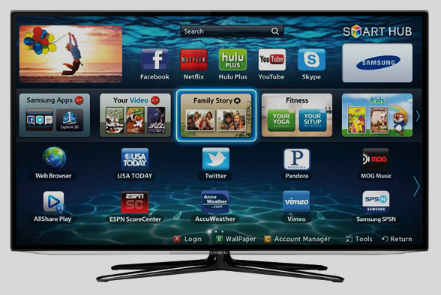
Smart tv can:
Stream directly from your TV, no extra equipment necessary
Stream all the major services like Netflix, HuluPlus, YouTube
Stream music with Pandora
Connect to Social Media
Facebook
Twitter
Flickr

Slide 10
Streaming Services

Slide 11
Current and past programming from networks like:
ABC, NBC, FOX
ABCFamily, Comedy Central, FX
CW, History/H2, HGTV
Original programs
30 day free trial, $7.99, $11.99 without commercials
Movies and Original programs from Showtime for an addition $8.99

Slide 12
Thousands of movies and TV episodes
Commercial free
Original programming: House of Cards, Marco Polo, Orange is the New Black
30 day free trial, $7.99 for basic subscription

Slide 13
Current and Live CBS programming
Ad free Classic Show Library
Earlier episodes of the current season as well as prior seasons
7 day free trial, $5.99 per month

Slide 14
HBO shows including Game of Thrones, True Detective, The Wire, and Veep
Also includes movies, documentaries, comedy specials
Free 30 day trial membership, $14.99 per month
Streams to all devices now

Slide 15
For Amazon Prime members, tens of thousands of movies and TV shows, including The Americans, Justified, and Downton Abbey are available to stream instantly, at no additional cost.
30 day free trial, $99 per year, includes free two day shipping, Prime Music, Prime Photos, and Kindle Lending Library

Slide 16
Stream LIVE TV including networks such as ESPN, ESPN2, AMC, TNT, TBS, Food Network, HGTV, Travel Channel, Adult Swim, Cartoon Network, Disney Channel, ABC Family, CNN, and more.
Video on demand
7 day free trial, $20 per month for “Best of the Live TV” subscription. Other packages available including HBO

Slide 17
Can I Stream for Free?
Hoopla @ MPPL
Stream thousands of movies and TV episodes FOR FREE! (They have music too!)
Use your MPPL Library Card and PIN to create an account.
5 items a month (they have ebooks, comic books, and music too!)
Apps for iPad/iPhone, Android devices, and Kindle Fire
Stream directly from your PC

Slide 18
Broadband Access
How fast?
Below are the Internet download speed recommendations per stream for playing movies and TV shows through Netflix.
0.5 Megabits per second - Required broadband connection speed
1.5 Megabits per second - Recommended broadband connection speed
3.0 Megabits per second - Recommended for SD quality
5.0 Megabits per second - Recommended for HD quality
25 Megabits per second - Recommended for Ultra HD quality
Source: Netflix.com

Slide 19
Indoor Digital Antenna

Slide 20
Can I “Cut the Cord”?
That depends ☺ Here are some questions to consider when making your decision:
Are you fed up with increasing prices?
Are you paying for channels you don’t watch?
Are you paying tons of fees and taxes?
How does the cable company’s customer service treat you?
Are you stuck in a two year contract?

Slide 21
Guides to Help You Decide
TV Streaming Price Guide http://www.theverge.com/a/online-tv-stream-price-guide
Best Streaming Video Services 2015 http://www.tomsguide.com/us/best-streaming-video-services,review-2625.html
Best Streaming Players: A Review http://www.tomsguide.com/us/best-streaming-players,review-2140.html
Smart TV: Everything You Need to Know http://www.tomsguide.com/us/smart-tv-faq,review-2111.html
Ultimate Cord Cutters Guide http://www.pcmag.com/article2/0,2817,2478213,00.asp

