Slide 1

VLOOKUP Function
Tech Tuesday
January 5, 2016

Slide 2
What is VLOOKUP?
A Function in Excel (and also in Google Sheets) for finding specific information in a spreadsheet
Looks for a value in the leftmost column of a table, and then returns a value in the same row from a column you specify
2

Slide 3
When is VLOOKUP used?
Some common uses:
Look up a price in a price list with many part or model numbers
Look up info tied to a last name (e.g. phone number, email address) in a contact list
Cross reference (or combine) two lists of data that have some columns in common
3

Slide 4
How is it used ?
The “V” in VLookup stands for vertical. It is used in spreadsheets where the data is arranged vertically in the spreadsheet and the information for each item is shown in a distinct row of the spreadsheet.
  (There is a HLOOKUP function for data that is arranged horizontally, but it not used as often)
Two methods of searching
  Exact Match
  Approximate Match
The secret to VLOOKUP is to organize your data so that the value you look up (e.g. employee’s last name) is to the left of the return value you want to find (employee’s birthday).

Slide 5
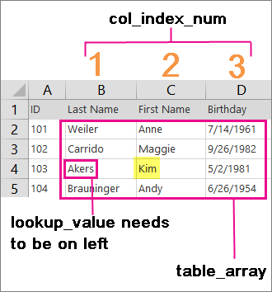
VLOOKUP Function Syntax
VLOOKUP (lookup_value, table_array, col_index_num, [range_lookup])
lookup_value
table_array
col_index_num
range_lookup

Slide 6
lookup_value (required)
The value you want to look up. The value you want to look up must be in the first column of the range of cells you specify in table-array .
For example, if table-array spans cells B2:D7, then your lookup_value must be in column B. Lookup_value can be a value or a reference to a cell.
Best if the lookup_value is unique in your data

Slide 7
table_array (required)
The range of cells in which the VLOOKUP will search for the lookup_value and the return value.
The table_array can be defined by a range (e.g. $B$4:$G$14) or a Range Name
(Do not use Relative Cell References if you plan to copy/paste the formula)
The first column in the cell range must contain the lookup_value. The cell range also needs to include the return you want to find.

Slide 8
col_index_num (required)
The column number (starting with 1 for the left-most column of table-array) that contains the return value.
Note: Not necessarily the column number of the whole spreadsheet

Slide 9
range_lookup (optional – but used frequently)
A logical value that specifies whether you want VLOOKUP to find an exact match or an approximate match:
  TRUE assumes the first column in the table is sorted either numerically or alphabetically, and will then search for the closest value. This is the default method if you don't specify one.
  FALSE searches for the exact value in the first column.

Slide 10
VLOOKUP (lookup_value, table_array, col_index_num, [range_lookup])

Slide 11
Example 1 – Approximate Match

Slide 12
Example 1 – Approximate Match

Slide 13
Example 2 – Sales Order with Price List
Objective: Provide Sales team with an order form that will automatically fill in prices for items
Create spreadsheet form with two worksheets
  Tab1 is the Sales Order form
  Tab2 is the Price list
Use VLOOKUP to populate the Sales Order with the correct prices

Slide 14
Example 2 – Sales Order with Price List
Tab1 – Sales Order form
Item # | Description | Price
A123 | Sweater - blue | $ 36.00
A124 | Sweater - red | $ 38.00
A125 | Sweater - green | $ 42.00
A126 | Shirt - white | $ 22.00
A127 | Shirt - blue | $ 19.00
A128 | Shirt - yellow | $ 19.00
A129 | Pants - black | $ 26.00
A130 | Pants - gray | $ 28.00
A131 | Pants - navy | $ 27.00
Tab2 – Price list

Slide 15
Example 2 – Price List
Here are the VLOOKUP formulas added for Description and Unit Price

Slide 16
Example 3 – Combining two spreadsheets
File: VLOOKUP – combine 2 sheets.xlsx
Tab1: Birthdays
Tab2: Flowers
Objective: Have two sheets with some columns of data in common across both sheets. Combine the data into a single sheet

Slide 17
Example 3 – Combining two spreadsheets

Slide 18
Example 3 – Combining two spreadsheets

Slide 19
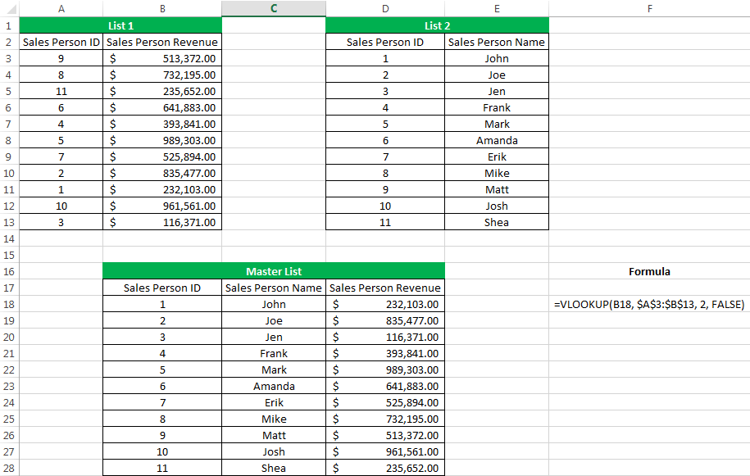
Another example of combining two spreadsheets

Slide 20
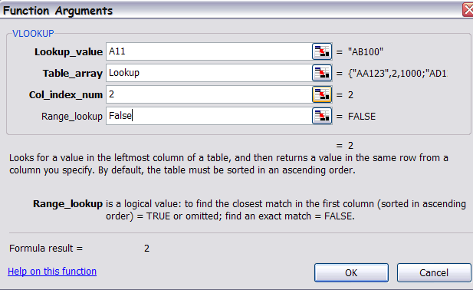
Using the Insert Function box

