Slide 1
Microsoft OneDrive
By Robin O'Neill

Slide 2
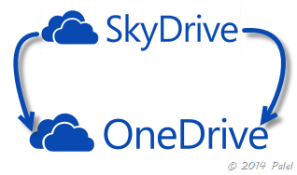
Background
Cloud storage is not new.
Launched by Microsoft in 2007.
Known then as SkyDrive. Name formally changed to OneDrive.

Slide 3
What is it used for?
Free cloud storage!
Web based. No flash drive needed.
15 GB totally free storage! You can add more.
For photos, files, folders, and documents you create.

Slide 4
It includes Free Microsoft Office online
Microsoft Word
Microsoft Excel
PowerPoint
Not imitation software, it's the software you know! You will recognize the icons.

Slide 5
How is it used?
Example 1: You work on a project during the day and want to finish it at home. In the past, you would have to email the document to yourself or save it to a flash drive.
Now you upload to OneDrive (or drag and drop) and simply open it at home on your computer.
Example 2: In the past, students would email attachments back and forth with teachers. Now you simply click a share button.

Slide 6
Collaborate with others
In the past, to get input from others, you would email attachments back and forth.
Now you can collaborate in real time at the same time by clicking a share button.

Slide 7
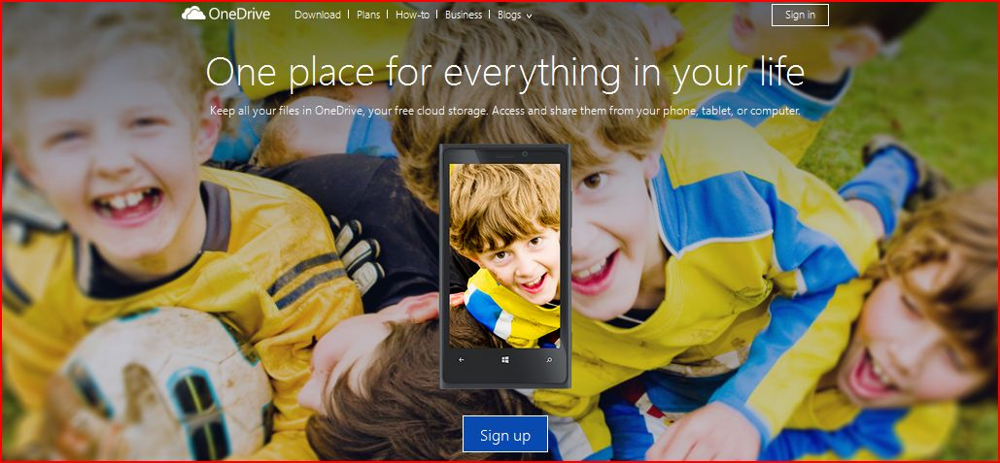
How to get it
Go to OneDrive.com. Click on the link onedrive.live.com
You may have it if you have hotmail, a Microsoft account, or Windows 8.0 or above.
Sign in with your Microsoft I.D. or sign up. It's simple and easy. Takes Minutes.

Slide 8
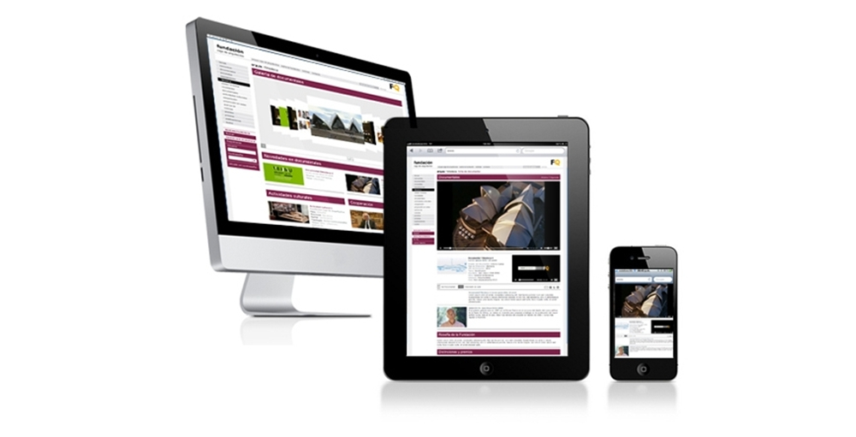
Sync your files automatically over multiple devices by downloading the app.
You can choose which files to sync.
PC, Mac
Smartphones
iPads, Tablets

Slide 9
Fetch Feature
Allows you to remotely access the PC where your files are stored to fetch a file or folder.
PC must be on and have internet connection.

Slide 10
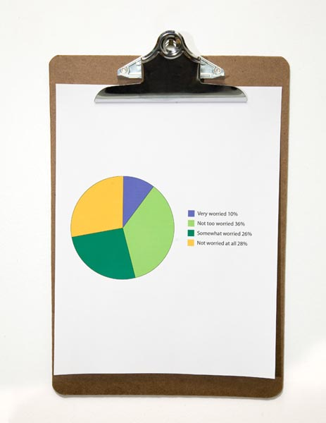
Excel Survey
One of the best features.
You can create surveys and forward. Excel will tabulate the results for you when each person responds to the survey.
Example: reunions, office meetings
See tutorial:
https://www.youtube.com/watch?v=gNB6WOd0cds

Slide 11
File management
Once the OneDrive app is downloaded, you can drag and drop files, copy and paste, or upload any files from your PC.

Slide 12
Documents can be embedded to the Web
No more attaching and emailing.
Share files by simply entering email address.
Or embed a link in a blog or web page!

Slide 13
No more missed homewok.
PRC students can upload any Training Resource files and practice at home.

Slide 14
Tips
You can add other great apps like Cam Scanner to scan photos or documents, and upload to your drive.
This includes receipts, invoices, etc. Cam Scanner adjusts to a perfect picture and sorts to the right folder.

Slide 15
Quick OneDrive tutorial:
https://www.youtube.com/watch?v=RZoYvmI9L9E

Slide 16
Sources:
Mastering OneDrive and Office Online by Saqib Kahn - Kindle Books
YouTube: Microsoft OneDrive Tutorial - Technology for Teachers and Students
YouTube: Creating Excel Survey by Steven Wong

