Slide 1
Tech Talks: Navigating Your Smart Phone
By: Friendly and Hip 20 year olds Alex and Sydney
Notes:
<number>

Slide 2
A few things...
We are using the templates for older models because they apply to every new upgrade
If you have a newer model we can help you individually
Notes:
<number>

Slide 3
Wifi and Data
Wifi
Connection allowing computers, smartphones, etc to communicate wirelessly
Exists in most office buildings and homes
Often requires a password
Unlimited Usage– you will not be charged by your phone company for using it
Notes:
<number>

Slide 4
Wifi and Data
Data
Limited per month by cell phone provider
Going over the limit incurs fees
Low signal in very rural or crowded city areas
Notes:
<number>

Slide 5
Wifi and Data
Both
Allows you to use email, surf the web, etc
Can be turned on and off at any time
Notes:
<number>

Slide 6
Wifi and Data
Wifi
Both
Data
Connection allowing computers, smartphones, etc to communicate wirelessly
Allows you to use email, surf the web, etc
You are given a limited amount per month by your cell phone provider
Can be turned on and off at any time
Going over the limit incurs fees
Exists in most office buildings and homes
Often requires a password
Will have low signal in very rural or crowded city areas
Unlimited Usage– you will not be charged by your phone company for using it
Notes:
<number>

Slide 7
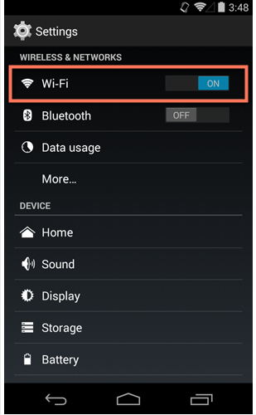
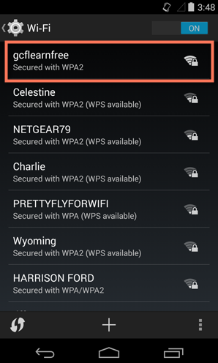
How to Connect to Wifi (applies to both)
Find this icon, scroll to Wireless and Networks
On this screen turn on Wifi
Choose which network you’d like to connect to
Notes:
<number>

Slide 8
Email vs. Text
Text Message Icon
Gmail icon (required for Android devices)
Notes:
<number>

Slide 9
Text Messaging
Informal
Limit 160 characters a message
Can attach pictures, no documents or PowerPoints
Difficult for groups
Notes:
<number>

Slide 10
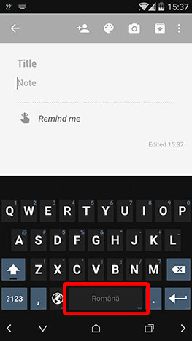
Look for this icon to attach photos, videos, and other media within your text messages/emails
The space bar highlights what language you are texting in
Notes:
<number>

Slide 11
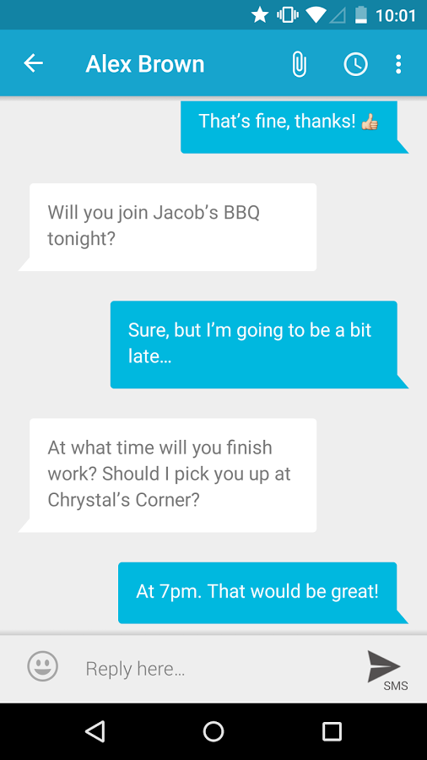
A Typical Conversation via Text Message
This is an emoji, you can find them by clicking the smile icon
Notes:
<number>

Slide 12
Email
Formal
No limit in characters per message
Can attach PowerPoints, Excel files, etc.
Common for large teams to communicate with each other
Notes:
<number>

Slide 13
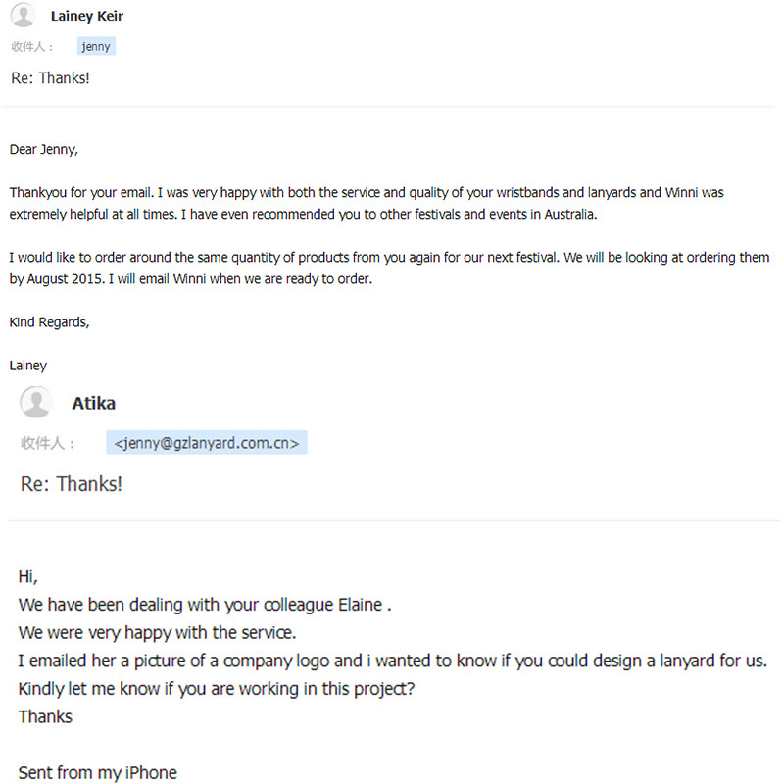
A Typical Email Correspondence
Notes:
<number>

Slide 14
iPhones for Beginners
Notes:
<number>

Slide 15
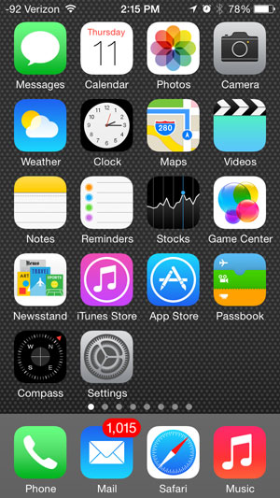
Navigating your home screen
Notification Bar– shows battery life and data/Wifi
Take pictures and videos here
Store pictures on your device
Default Calendar application
Notes:
<number>

Slide 16
Navigating your home screen
Application used for text messaging
Apple Maps
(A good alternative is the application Google Maps)
Set alarms, see a different time zone with World Clock,
and use the stop watch and timer functions
Weather Application-Will use your location to show the weather where you are
Notes:
<number>

Slide 17
Navigating your home screen
Shows stocks of some well known companies, you can set ones you want to track
Set reminders based on time or other factors
Write notes to yourself
Notes:
<number>

Slide 18
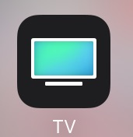
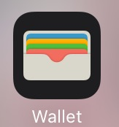
Navigating your home screen
Access videos you have downloaded
Now an app called Wallet. Used to store card information in order to "Apple Pay", as well as other cards such as gift cards and rewards cards
Download apps here
Download music and movies here
Four most commonly used apps, you can change these by holding down apps and dragging them
Notes:
<number>

Slide 19
Navigating your home screen
Default news app
Why have a compass when you have a map? I don’t know. But it is here for you.
Change personal info, accessibility (larger font),
sound settings,
and updates
Notes:
<number>

Slide 20
Phone Application-
Add favorite contacts for "Speed Dial",
see your recent calls and contacts,
use the keypad, and see voicemails
Email Application
Default Internet
Application
Access the music you have downloaded
through the iTunes Store
Notes:
<number>

Slide 21
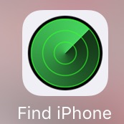
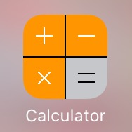
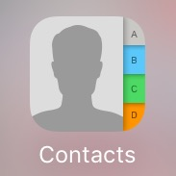
Other Important Applications
Find Phone-Allows other devices to find your phone in the event that you lose it. You can also see where your other Apple Devices are
Calculator
Contacts-Allows you to save numbers, email addresses, and street addresses into your phone for easy access
Facetime-Allows you to video chat with people who have Apple Products
Voice Memos-Allows you to record audio
Notes:
<number>

Slide 22
Android Phones for Beginners
Notes:
<number>

Slide 23
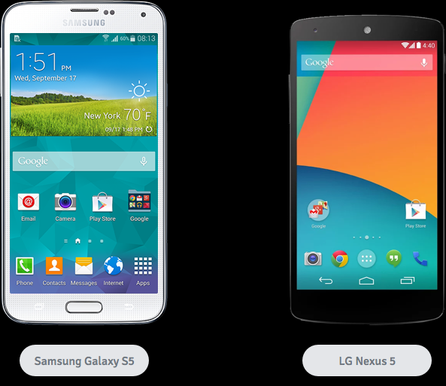
Intro– Why does your phone look different than mine?
Both phones are Android under different manufacturers

Slide 24
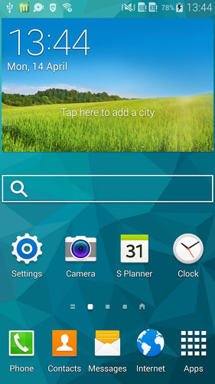
Navigating your home screen
Notification Bar– shows battery life, data/Wifi, voicemail, and any app updates
Add your hometown and you will see the weather
Take pictures

Slide 25
Navigating your home screen
Search Google directly
Change personal info, sound settings, updates
Set alarms, use a stopwatch, or see the time for places around the world
Notes:
<number>

Slide 26
Navigating your home screen
Pre Installed Calendar
Default Text Messaging App
View all apps installed

Slide 27
Navigating your home screen
These four apps stay at the bottom even when you move home screens. They can be changed to whatever you use most often.
Default Browser
Newer Models may have both of these in the phone app
Notes:
<number>

Slide 28
Other features of your phone
Takes you back one screen in an application
Takes you to main home screen, holding it down brings up Google Now
Brings up all recent apps you’ve used, close them by swiping left or right
All photos you take are stored here
This is Google’s photo app, pre-installed on some devices, you can choose to use it

Slide 29
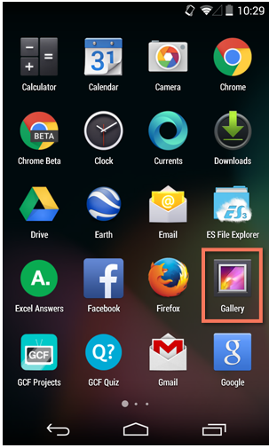
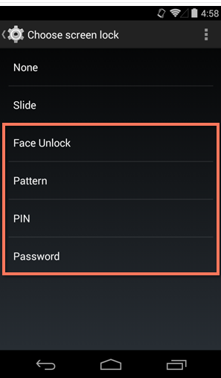
Common Tasks (to both systems)
Drag an icon from the all apps screen to a home screen. Do the same to discard
In settings, go to Security and then choose one of four ways to protect your phone

Slide 30
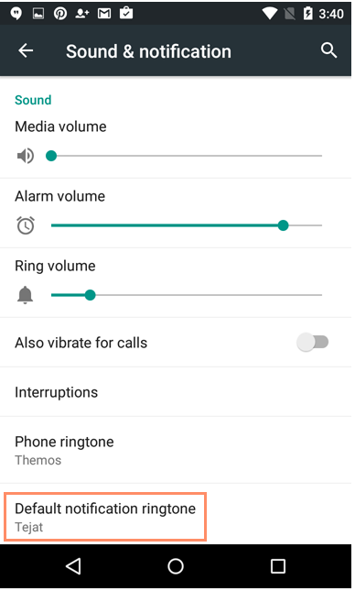
In Settings, find Sound and Notification. Here you can choose how loud videos, your ringers, and alarms are. You can also choose a ringtone.

Slide 31
Miscellaneous
Share icon– Click on this to share the media you are looking at with friends. It connects to Facebook, email, text, and other apps.
Download new apps to your phone by clicking on this icon

Slide 32
Questions?

